Slide 1
Ethical Duties & Electronically Stored Information
Fred Behning, EnCE,
Director of Digital Forensics
100 Congress Ave, Ste 2000 Austin, TX
FBehning@Califorensics.com
512-680-5222
Notes:
Hello everyone and welcome to this presentation of Ethical Duties and Electronically Stored information.
My name is ________________ and This presentation is prepared to provide attorneys with one MCLE credit in the area of Ethics.
Before we get started, a little background about myself, Califorensics and our MCLE presentation program.
I am currently ________________
[Discuss some background and certifications.]
Califorensics is digital forensics and ediscovery company headquartered in Sacramento since 1998.
We decided just over a year ago that the best way to grow the business is to offer for free something of value to our clients and potential clients.
We realized that most of our clients are small to medium sized law firms who have a requirement for continuing legal education.
So what better way to help than to provide training that gives Minimum Continued Legal Education (MCLE) credit in subjects they need – for free?
We have given these presentations to numerous bar associations, DAs and Public Defender offices, and individual law firms throughout California and the feedback has been extraordinary!

Slide 2
ABOUT CALIFORENSICS
Helping attorneys win cases by finding, interpreting, and explaining digital evidence.
Business Litigation
Employment Law
Criminal Law
Schools & Higher Ed
Family Law
Medical Malpractice
Plaintiff, defense, or neutral
Any data source or data type
Collection, analysis, expert testimony; e-discovery and hosted review
17 years in business
1,500 clients served nationwide
Locations in Northern California, Southern California and Central Texas

Slide 3
FRED BEHNING
BS Forensic Science – Baylor University
Over 13 years experience in Digital Forensics
EnCase Certified Examiner
Mobile Phone Seizure Certified – BK Forensics
Licensed Texas Private Investigator
High Technology Crime Investigation Association Member
Testified in Texas Civil Court – Harris County

Slide 4
AGENDA
DEFINITIONS
ESI, eDiscovery, Digital Forensics, Metadata
ESI: ETHICAL GUIDELINES
9 Skills Of Competency
EXAMPLE CASES
Reference Cases And Court Opinions

Slide 5
DEFINITIONS

Slide 6
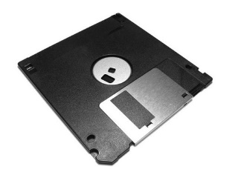
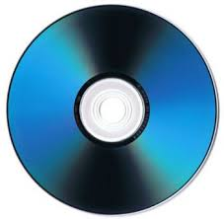
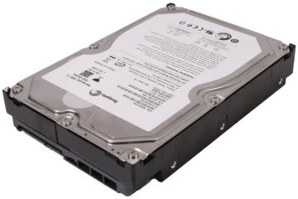
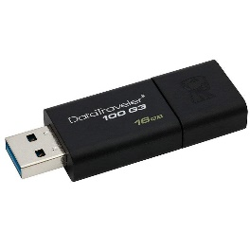
ELECTRONICALLY STORED INFORMATION (ESI)
Any data that resides on electronic or digital media.
Includes data stored on:
Computer Disks
Printer or Fax memory
Tape storage
Databases
Network Storage
Mobile Devices
Cloud Services
Social Media
ANY Digital media that may be invented
Notes:
Electronically stored information or ESI is practically anything that can be stored on electronic or digital media. This means computer discs, CDs DVDs, printer and fax memory, backup tapes, databases, mobile devices, The Cloud, Facebook, twitter, Instagram. As well as any digital media that may be invented in the future.
Think Amazon Alexa and smart fridges!

Slide 7
SOURCES OF ESI: DEVICES
Desktop | Smart Phone | Personal Digital Assistant
Laptop | Digital Camera | Answering Machine
Music Player | Tablet | GPS
Network Equipment | Video Camera | Security System
Not-so-smart Phone | Vehicle CANbus | eReader
Printers | Video Game System | IOT Devices

Slide 8
TYPES OF ESI
Audio Files | Databases | Folders | PDF, XPS | Voice Mail
Blog Postings | Deleted Data | Geolocation Data | Schematics | Web Pages
Text/Chat messages | Device Settings | Images | Social Media Postings | Word Processing Docs
Computer Applications | Diagrams | Internet Activity | Spreadsheets | Disk Images
Computer Programming Code | Drawings | Logs | Pictures | Virtual Disks
Connected Device Information | Email | Network Information | Video | Presentations
Notes:
The list of types of ESI is nearly endless. Some are fairly common such as word processing documents, spreadsheets, presentations, etc. Others you may not think of immediately but still common like text messages, YouTube videos, social media postings. Still others most might not even consider like virtual hard drives, deleted data, Internet history and many others.
The point is that ESI is everywhere, takes many different forms and it is important to understand what you may be dealing with when a case is going to involve ESI.
Any questions on ESI?

Slide 9
ELECTRONIC DISCOVERY (eDiscovery)
The process of locating, securing, and searching ESI to use as evidence in a legal proceeding.
Notes:
Ediscovery or electronic discovery is essentially the process of finding, preserving, collecting, and reviewing the ESI that is relevant to your case.
Here is what is known as the eDiscovery Reference Model or EDRM. The EDRM helps lay out the order of operations in eDiscovery: Identification, Preservation and Collection, Processing Review and Analysis, Production, and finally Presentation.
Note that it actually starts with Information Governance, but that is the responsibility of the owner of the ESI. Information governance sets out the rules of ESI classification and retention among other things.
Where most of us in this room will find ourselves is between the Identification and Presentation processes. These processes are typically team efforts that are technology heavy on the left side and attorney heavy on the right.
The goal of the EDRM is to demonstrate how the volume of ESI is reduced while the relevance of the ESI is increased as the process flows left to right.
I could speak for an hour on each process here in the EDRM – and have done that – but for now it is just important that you understand the general idea here. That we typically start with a high volume of ESI, reduce it down to the most relevant information and present that in court. Questions?

Slide 10
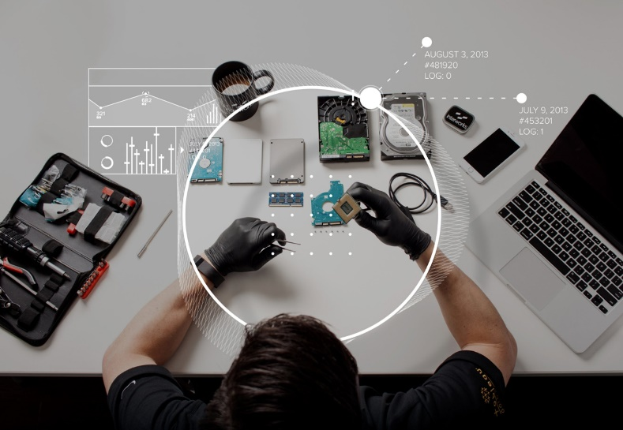
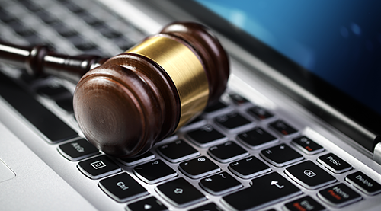
DIGITAL FORENSICS
The use of specialized techniques for collection, authentication, recovery and analysis of ESI.
Notes:
Digital forensics is a field of technology, the goals of which are to put together a story, prove or disprove a hypothesis, and recover deleted or otherwise lost ESI. The practice makes use specialized tools and techniques that are applicable in both criminal and civil investigations as well as is the eDiscovery process.
Think of the TV show CSI. Much of the investigation in the show relies on evidence that found using digital forensics.
Again, I could talk about Digital Forensics all day but that is not the topic of this presentation. I just want you to have a general idea of what it is.

Slide 11
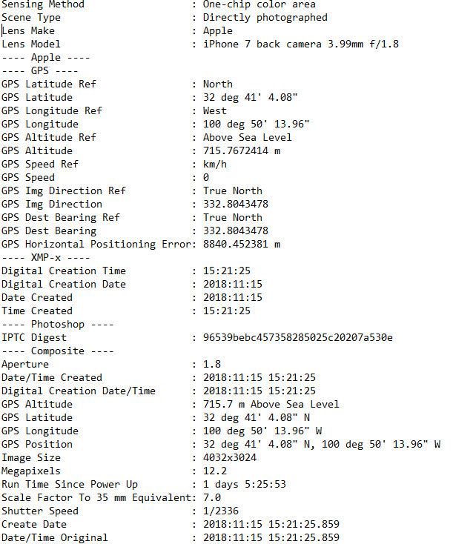
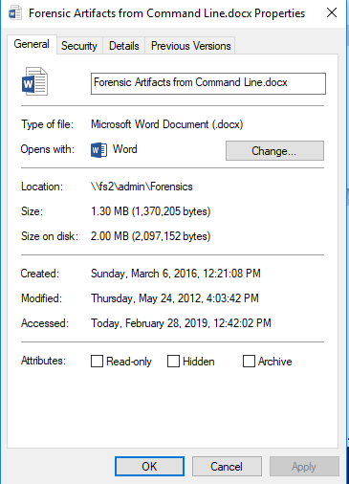
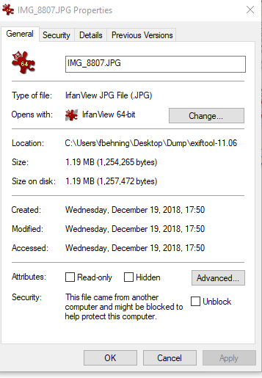
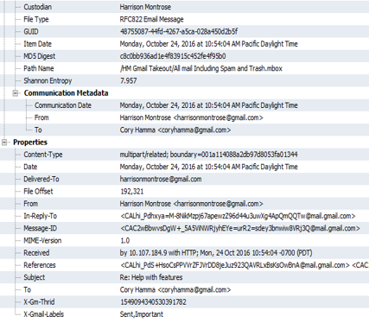
METADATA
A set of data that describes and gives information about its parent object.
Includes items such as:
Modified, Accessed, and Created (MAC) Dates and Times
Digital Signatures
Original Author, Owner, Company
Network traversal
Sender and Recipients
Geolocation of Photo
Camera settings
Notes:
Ok, I am going to get a little technical here and talk about Metadata. Metadata is the ESI that you don’t see. It is the data that describes other data.
For instance if you create a Word document, you can look at its properties and see the author name, the time and date the file was create, how long it was open for editing, and the last person to edit it.
All of this is known as metadata.
Photos might have information about the camera that took the picture or even the geolocation where the picture was take.
Email has a list of all the servers it went through from the time it was sent to the time it was delivered.
This metadata is very important for digital forensics as well as ediscovery as it helps put together a more detailed picture of events.
Any questions on any of the preceding information?

Slide 12
ESI: ETHICAL GUIDELINES

Slide 13
ELECTRONIC DISCOVERY & ESI
Applicable FRCP Sections
Rule 16(b): Pretrial Conferences; Scheduling; Management
Rule 26(b): Discovery Scope and Limits
Rule 26(d): Timing and Sequence of Discovery
Rule 26(f): Discovery Planning Conference, Disclosure & Form of Production
Rule 33: Interrogatories to Parties
Rule 34: Form of Production for ESI
Rule 37(a): Motion for an Order compelling Disclosure or Discovery
Rule 37(e): Failure to Preserve ESI; “Safe harbor” from Sanctions

Slide 14
ELECTRONIC DISCOVERY & ESI
Applicable TRCP Sections
192.4 Limitations on Scope of Discovery.
The discovery methods permitted by these rules should be limited by the court if it determines, on motion or on its own initiative and on reasonable notice, that: (a) the discovery sought is unreasonably cumulative or duplicative, or is obtainable from some other source that is more convenient, less burdensome, or less expensive; or (b) the burden or expense of the proposed discovery outweighs its likely benefit, taking into account the needs of the case, the amount in controversy, the parties' resources, the importance of the issues at stake in the litigation, and the importance of the proposed discovery in resolving the issues.
193.3 (d) Asserting a Privilege
A party who produces material or information without intending to waive a claim of privilege does not waive that claim under these rules or the Rules of Evidence if - within ten days or a shorter time ordered by the court, after the producing party actually discovers that such production was made - the producing party amends the response, identifying the material or information produced and stating the privilege asserted.
196.4 Electronic or Magnetic Data.
To obtain discovery of data or information that exists in electronic or magnetic form, the requesting party must specifically request production of electronic or magnetic data and specify the form in which the requesting party wants it produced. The responding party must produce the electronic or magnetic data that is responsive to the request and is reasonably available to the responding party in its ordinary course of business. If the responding party cannot - through reasonable efforts - retrieve the data or information requested or produce it in the form requested, the responding party must state an objection complying with these rules. If the court orders the responding party to comply with the request, the court must also order that the requesting party pay the reasonable expenses of any extraordinary steps required to retrieve and produce the information

Slide 15
COMPETENCY
What are an attorney’s ethical duties in the handling of discovery of electronically stored information?
Basic understanding of, and facility with, issues related to eDiscovery and ESI
Duty of competence may vary case-by-case, requiring a higher level of technical knowledge
An attorney lacking the required competence for e-discovery issues has three options:
Acquire sufficient learning and skill before performance is required
Associate with or consult technical consultants or competent counsel
Decline the client representation
Lack of competence in eDiscovery issues also may lead to an ethical violation of an attorney’s duty of confidentiality
Notes:
The Formal Opinion 2015-193 from the California State Bar answers the question: What are an attorney’s ethical duties in handling the discovery of electronically stored information?
It breaks down into four main points:
The first point, an attorney must have a basic understanding of and facility with issues related to eDiscovery and ESI. By listening to the first part of this presentation and maybe a little experience you have gained a basic understanding. The facility with part is a little different. This means that an attorney must be able to anticipate and deal with issues that may arise when dealing with eDiscovery and ESI.
Issues like changes in metadata when ESI is not collected in a forensically sound manner, or, overproduction or underproduction of ESI due to improperly formatted key terms. These are a couple of very common examples, but as you can see from the vast combinations of data sources and types of ESI many negative things can happen.
The second point is that duty of competence may vary case by case, requiring a higher level of technical knowledge. This means some of your cases will require very little if any expertise with ESI or eDiscovery while other cases may be far to complex in terms of ESI for you to handle alone.
For instance, lets say that Bill is a divorce attorney. Most of his cases are pretty simple and the most ESI involved is bank statements, pay and other financial statements, and some business documents. Bill can handle all of this with no problem. However, in his new case, his client’s wife is accusing the husband of looking at inappropriate/illegal images on their computer, which, of course, Bills client denies. While Bill may feel competent that he could review the computer and see if there are inappropriate images there, He may not be technically competent enough to understand all the metadata surrounding the images and say for sure whether or not they were downloaded or viewed by his client.
The third point is that an attorney lacking the required competence for eDiscovery issues has three options:
Acquire sufficient learning and skill before performance is required
Associate with or consult technical consultants or competent counsel
Decline the client representation
The first option is great if you have the time. I always advocate for self-improvement and seeking knowledge. The second option, though, is the most likely choice because you want to give your client the best representation available. Who here would rather choose to turn away the client? Maybe that is the best option due to time or financial constraints.
The fourth point is that Lack of competence in eDiscovery issues may lead to an ethical violation of an attorney’s duty to confidentiality. This is important. It means to me that if you are not 100% sure of your competence and have not otherwise consulted an outside expert but still represent the client, you can be struck with an ethical violation.
We covered quite a bit here. Any questions before we move on?

Slide 16
NINE SKILLS Of COMPETENCY
Initially assess e-discovery needs and issues, if any
Implement or cause to implement appropriate ESI preservation procedures
Analyze and understand a client’s ESI systems and storage
Advise the client on available options for collection and preservation of ESI
Identify custodians of potentially relevant ESI
Engage in competent and meaningful meet and confer with opposing counsel concerning an e-discovery plan
Collect responsive ESI in a manner that preserves the integrity of that ESI
Perform data searches
Produce responsive non-privileged ESI in a recognized and appropriate manner
Notes:
So how do you judge your own level of competence? It can be tough but at least Formal Opinion 2015-193 gives a list of nine skills in which you should be competent:
[read the nine skills

Slide 17
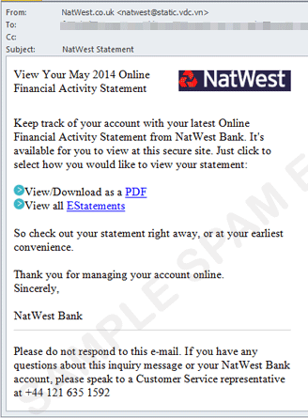
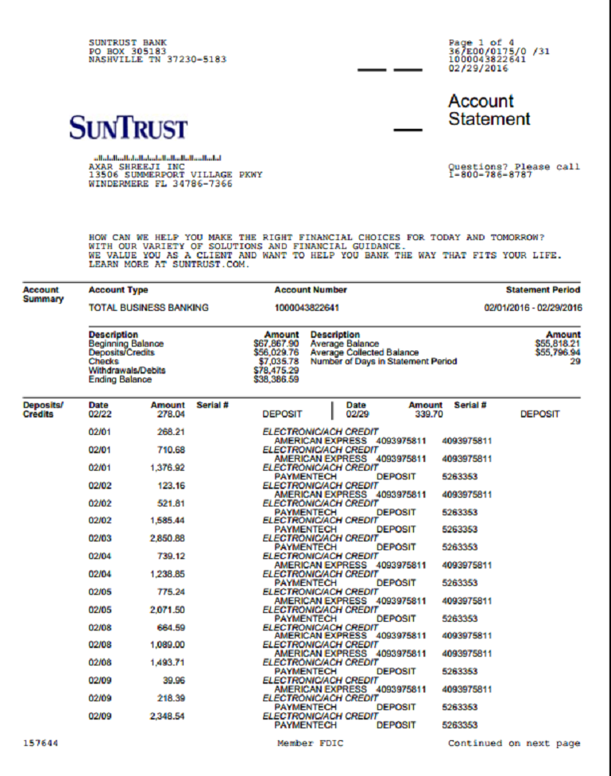
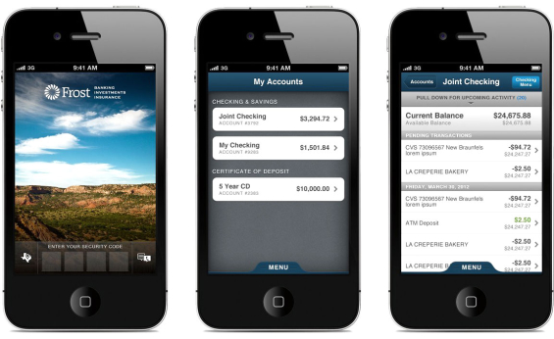
SKILL 1: ASSESS
Initially assess e-discovery needs and issues, if any.
What information could I possibly be looking for?
New data formats – cloud hosted
client may not be aware
Where could that information be located?
My client’s possession
Opposing client’s possession
3rd party possession
Notes:
How do you do this? First, think of the content you are looking for. Is it bank statements, conversations, photos, internet activity?
Next, consider the type of ESI you need to collect. Bank statements come in the mail, email, email as a link, are downloaded as a PDF, spreadsheet, quickbooks file, etc. Conversations may be in text messages, email, social media.
Photos may be standalone files, embedded in a document, displayed on a webpage, only available for a limited time on snapchat, only shared with few people on Instagram.
Internet activity can be found in the browser cache, logged on a router, on a mobile device, on logs of the actual website, in volatile memory, in deleted content.
Now consider all the places any of that can be stored – refer to the sources of ESI slide.
Next, consider where the ESI sources are physical located. Are they in your clients possession? Possession of opposing party? With a third party?
You will have to devise a plan to take possession or get forensically sound copies of the ESI so it can be processed and reviewed.

Slide 18
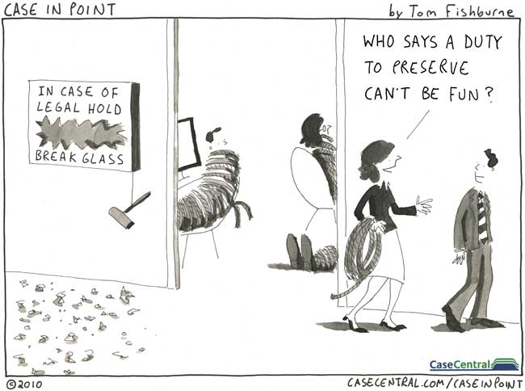
SKILL 2: ACT
Implement/cause to implement appropriate ESI preservation procedures.
Time Sensitive (ephemeral vs persistent)
What information could be deleted or wiped?
Phone company and Internet Service Provider (ISP) records
Backups
Emails
Retention Policies
Ask IT
Litigation Hold?
Notes:
You must understand that some ESI is volatile meaning that if it is not preserved at the time a computer is seized and still powered on, it will be lost. An example of this is computer memory which can store much information but will be lost as soon as power is removed.
Other ESI is ephemeral meaning that it is intentionally temporary or restricted to certain file sizes. Windows event logs are like that. In order to save space they are overwritten once they grow to around 20MB. Older entries are deleted and new entries are appended.
Email is another one, especially corporate email. I mentioned information governance earlier when discussing the EDRM and here is one place it comes into play. In order to space and storage fees as well as limit their exposure in litigation, businesses will often set an intentionally short email retention period – like six months. So any email that is not otherwise preserved will be deleted after it is six months old.
You must understand that just opening a document can change its metadata. Some ESI can be deleted just by viewing it – think snapchat.
Another concern is that of proper preservation techniques. A simple copy and paste will change the metadata. Simply connecting a USB device to a computer will change the system logs. Forensics professionals use write-blockers and other techniques to ensure that the ESI that is collected remains completely unchanged and indistinguishable from the original
Finally maintaining proper chain of custody documentation helps to ensure ESI is properly handled during preservation and transfer.

Slide 19
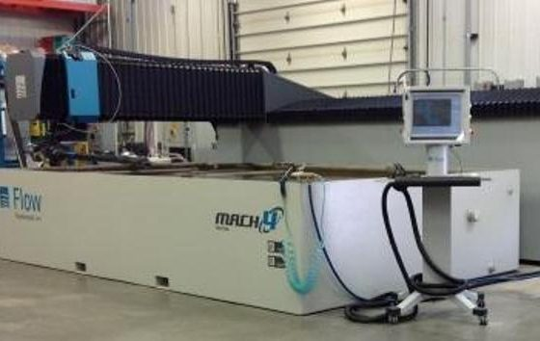
SKILL 3: ANALYZE
Investigate and understand a client’s ESI systems and storage.
Computer, Server, Backups, External Drives
Smartphone / Cell Phone
Cloud Storage/Backup (Google Drive, DropBox, OneDrive, CrashPlan)
Cameras / Video Surveillance
New Types of ESI
Notes:
Does your client have on premises email servers or is it in the Cloud? Do they have on-site or off-site backups that dictate how long it will take to retrieve ESI? Are smartphones or other devices involved? Do they use Cloud storage services like GoogleDrive or Dropbox? Will you need to review security / surveillance video?
A mentioned earlier the types and sources of ESI are almost endless and new ones appear frequently. It is important to properly interview your client and understand their systems and storage to make sure you don’t miss something important.

Slide 20
SKILL 4: ADVISE
Counsel the client on available options for collection and preservation of ESI.
Digital Forensics / E-Discovery Expert
Forensic Collection / Preservation to meet court requirements
Organizational integrity
Attorney retains evidence
Vendor or another attorney supervise collection
Having IT staff perform collection is usually insufficient
Notes:
The best option is typically to have an expert in the preservation and collection of ESI to perform the preservation and collection. Forensic experts know to handle ESI so that it meets all court requirements.
It may also be necessary to have a third party vendor or attorney supervise the collection.
Decide on who will retain the collected evidence. You may want to retain it or you may want your forensics vendor to handle the storage.
Having IT staff perform a preservation or collection with out supervision from a forensic expert is a bad idea. IT staff have different ideas when it comes to urgency and the integrity of the preservation.

Slide 21
SKILL 5: ASCERTAIN
Identify custodians of potentially relevant ESI.
Your client / opposing party
Other employees at the firm
IT Employees
Telephone / Cell Phone Companies
Internet Service Providers
Hosted Application Providers (Salesforce, Online Time Card, Facebook, DropBox, etc)
Email / Text Message CC Recipients
Notes:
This information comes not only from interviewing clients but also through the EDRM process.
Through diligent review of ESI other data custodians and potential data sources can come to light.
It is also important to consider the scope of the body of ESI.
Do you need phone records from the provider to authenticate what is found on the phone?
Multiple copies of ESI from different sources helps to prove authenticity

Slide 22
SKILL 6: AGREE
Engage in competent and meaningful meet and confer with opposing counsel concerning an e-discovery plan.
Work with your client to determine clear search terms.
Consult with e-discovery or forensics expert regarding potential search terms and also potential overbroad search terms.
Review data obtained from your clients before it is released to opposing counsel.
Do not rely on snap back method.
Notes:
An ediscovery plan will detail initial data custodians, data sources, search terms, preservation and collection methods, and time frames. Be sure to know what ESI is available and have a plan for how you want it collected.
We could have an entire class on search terms alone. Developing meaningful and accurate terms and getting agreement with opposing counsel early on will save much time and energy. Simple terms such as single words or short letter combinations, no matter how unique they may seem, usually result in huge volumes of irrelevant data.
Use very specific terms that include proximity and Boolean logic but be careful. For instance: “peanut butter” AND jelly w/1 sandwich will get different results than (“peanut butter and jelly”) w/1 sandwich.
Review closely the results of any search before releasing it to opposing counsel even if it was provided by your client. The claw back method may still disclose unwanted information to opposing parties.

Slide 23
SKILL 7: ACQUISITION
Collect responsive ESI in a manner that preserves the integrity of that ESI
Preserving the Integrity
Chain of Custody
Limiting Access to Data
Write Blocking / Working Copies
Proving Preservation of Integrity
Checksum – output of cryptographic algorithm. Digital Fingerprint
Digital Forensic Containers
Notes:
This one seems simple enough. But there are still pitfalls. If you are looking for “peanut butter and jelly sandwiches” you will probably find it. But if you don’t take the time to search “unsearchables” you may miss it entirely.
Unsearchables are files that contain images or representations of text but not actual text. Think of a scanned document or a photo of a document. Techniques such as Optical Character Recognition (OCR) can scan image files for text, extract that text, and make it searchable. OCR is not perfect and mistakes similar characters all the time. For instance the word “Fall” may be interpreted as “F@11” depending on the font and quality of the initial image. Ask for unsearchables and have a person review them if you believe they are critical.
Also, consider using alternate spellings of words in your search terms. If searching for “administrator” you will not find “adminstrator” or “adminsitrator”. Other examples include “color” and “colour”
If working with an eDiscovery pro, you can ask to run several sets of terms and then run searches with new terms against the results of the first searches.
Also make sure you are doing indexed searches and not just raw text searches. Indexed searches are very quick to run but take some time to get setup. The advantage is that if you run more than one search or many terms at once, the results are almost instantaneous. Raw data searches, on the other hand, are quick to setup, but take a long time to get results. If you have a single term and do not plan to do any other searches then a raw search will work. But as soon as you want to do a second search it will double the time with a raw search.

Slide 24
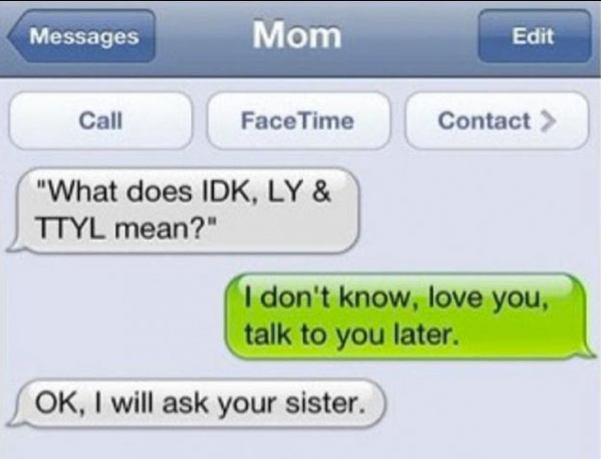
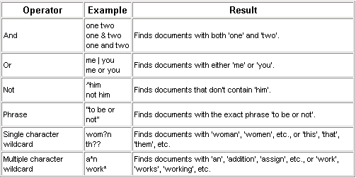
SKILL 8: ACTION
Perform Data Searches
- Search both searchable and non-searchable data
Some files may require OCR or manual review
- Boolean searches
Alternate spellings / misspellings
Notes:
This is where they separate the forensic professionals from the IT guys. Preserving the integrity of the ESI is paramount. If you cannot prove that the copy of that you have ESI is the same as the original, it can be argued that it has changed and may become inadmissible.
Forensic experts collect ESI in such a way that it is indistinguishable from the original. So much so that a proper forensic copy can be considered original evidence in court should the actual original be damaged or destroyed.
This is due to the fact that forensic experts document what is done, generate and verify digital signatures or hashes of everything they touch, use tools and techniques designed to not alter ESI, and track the chain of custody.
ESI that is forensically preserved and collected is typically stored in digital forensic “containers”. Think of zip files that alert you of even the smallest change.
This is valuable because it allows ESI to be transferred from one party to another with the integrity of the ESI still intact.

Slide 25
SKILL 9: ACTUALIZE
Produce responsive non-privileged ESI in a recognized and appropriate manner.
An attorney's ethical obligations relate to his own client’s ESI, and does not address the scope of an attorney’s duty of competence relating to obtaining an opposing party’s ESI.
Native Formats
PDF Formats
Load File (Relativity, Disco, Ipro, etc)
Common Metadata
Created/Modified/Accessed Dates, Location, Custodian, Checksum
Notes:
This means that if your client has responsive ESI, it must be produced to opposing counsel in a manner that is considered normal. What is normal? This could be several things. Normal could mean native documents such as printouts of a word processing document or the actual digital copy of that document.
Or it could mean converting that same document to a Portable Document Format (PDF) something that is not easily modified. It will likely require bates-stamps on each page indicating a document ID. If it is printed, it will also require the common metadata to be included. This is the file Modified, Accessed, and Created (MAC) timestamps, file system location, custodian information, and hash or checksum value for the file.
At this point you are prepared and feel competent in any case that involves ESI, right?
Does not address what an attorney should insist upon from opposing counsel – we recommend:
Natives
All metadata
Chain of Custody documents

Slide 26
CASE EXAMPLES

Slide 27
ETHICAL VIOLATIONS Trevino Texas Elec. Co-Op v. Dillard (Tex. 2005)
Trevino Texas Elec. Co-Op v. Dillard (Tex. 2005)
Party doesn’t need to take extraordinary steps to preserve ESI but must show good faith effort in preserving relevant ESI
Spoliation instruction can be presented to the jury after the court has determined:
Whether there was a duty to preserve ESI
Whether the spoliation was due to negligence or intentionality
Whether the spoliation prejudiced the other side’s ability to present the case
Intentional spoliation of relevant data raises presumption that the evidence was unfavorable to the party that failed to preserve the ESI.
Trevino, supra; Texas Elec. Co-Op. v. Dillard, 171 S.W.3d 201, 208-209 (Tex. App. – Tyler 2005)

Slide 28
ETHICAL VIOLATIONS Wal-Mart Stores, Inc v. Johnson (Tex. 2003)
When do you have a duty to preserve potential ESI?
Presumption that destroyed documents are unfavorable to the party responsible for the destruction only applies when that party had a duty to preserve the ESI.
Duty to preserve only applies when “a party knows or reasonably should know that there is a substantial chance that a claim will be files and that evidence in its possession or control will be material and relevant to that claim.”
Wal-Mart Stores, Inc. v. Johnson, 106 S.W.3d 718 (Tex. 2003) In Johnson, the Court noted that spoliation instructions have been given either for (1) a party’s deliberate destruction of relevant evidence; or (2) a party’s failure to produce relevant evidence or explain its non-production. However, the Court noted that such a duty to preserve evidence arises “only when a party knows or reasonably should know that there is a substantial chance that a claim will be filed and that evidence in its possession or control will be material and relevant to that claim.” .

Slide 29
Ethical Violations Weekley Homes LP. V HFG (Tex. 2009)
How hard can you look for ESI?
Weekley produced 31 emails. Plaintiff believed more existed and asked to have forensic investigators try to recover deleted emails from as far back as 2004.
TRCP 196.4 only referrs to data that is "reasonably available." .
Court created basic principles:
Need to show responding party had defaulted in its obligations and that additional searching could recover dleeted materials
Experts are needed only when retrieval of the data sought is feasible (privilege and privacy)
There needs to be some direct relationship between the electronic storage device and the claim itself
Weekley Homes LP litigation, 295 S.W.3d 309 (Tex. 2009) Having established the “basic principles” the court determined that “because plaintiff failed to demonstrate the particular characteristics of the electronic storage devices involved, the familiarity of its experts with those characteristics, or a reasonable likelihood that the proposed search methodology would yield the information sought, and considering the highly intrusive nature of computer storage search and the sensitivity of the subject matter…the trial court abused its discretion.”

Slide 30
ETHICAL VIOLATIONS State Farm Lloyds, Relator (Tex. 2017)
Is native file production too burdensome?
State Farm produced documents in "staic form" - i.e. tiff images
State Farm claimed "static form" productions are easier to bates number and generally produce for hearings and depositions
Homeowners objected citing the lack of metadata and internal doucment functionality in "Static Form" images
Court's opinion noted the interplay between discovery limits in rule 192.4 and produciton of ESI under rule 196.4
Court finds that the homeowners can request production in native format.
In Re: State Farm Lloyds, Relator, Nos. 15-0903, 15-0905 (Tex. Sup. Ct. May 26, 2017) The Texas Supreme Court, in an opinion delivered by Justice Eva M. Guzman, denied the petitions for writ of mandamus without prejudice, “affording the relator an opportunity to reurge its discovery objections” (regarding the requesting party’s request for a native file production) to the trial court in light of its opinion.

Slide 31
ELECTRONIC DISCOVERY & ESI
FRE 502(b) provides that inadvertent disclosure may not result in waiver of the privilege where “(1) the disclosure is inadvertent; (2) the holder of the privilege or protection took reasonable steps to prevent disclosure; and (3) the holder promptly took reasonable steps to rectify the error…”
FRE 502(d) provides: “A federal court may order that the privilege or protection is not waived by disclosure connected with the litigation pending before the court – in which event the disclosure is also not a waiver in any other federal or state proceeding”
FRE 502(e) further provides: “[a]n agreement on the effect of disclosure in a Federal proceeding is binding only on the parties to the agreement, unless it is incorporated into a court order”

Slide 32
Notes:
Thank you very much for your time and I hope you enjoyed the presentation.
If you did and are interested in our other MCLE offerings, please feel free to give our office a call to schedule a presentation!

