Slide 1
Constitutional Carry
Metropolitan protection services, llc

Slide 2
References
HOUSE BILL 1927 (FIREARM CARRY ACT OF 2021)
PENAL CODE
TITLE 7. OFFENSES AGAINST PROPERTY
CHAPTER 30. BURGLARY AND CRIMINAL TRESPASS
PENAL CODE
TITLE 10. OFFENSES AGAINST PUBLIC HEALTH, SAFETY, AND MORALS
CHAPTER 46. WEAPONS

Slide 3
What is “Constitutional Carry”?
Trained vs. Untrained
Licensed vs. Unlicensed

Slide 4
Rifle or Handgun?

Slide 5
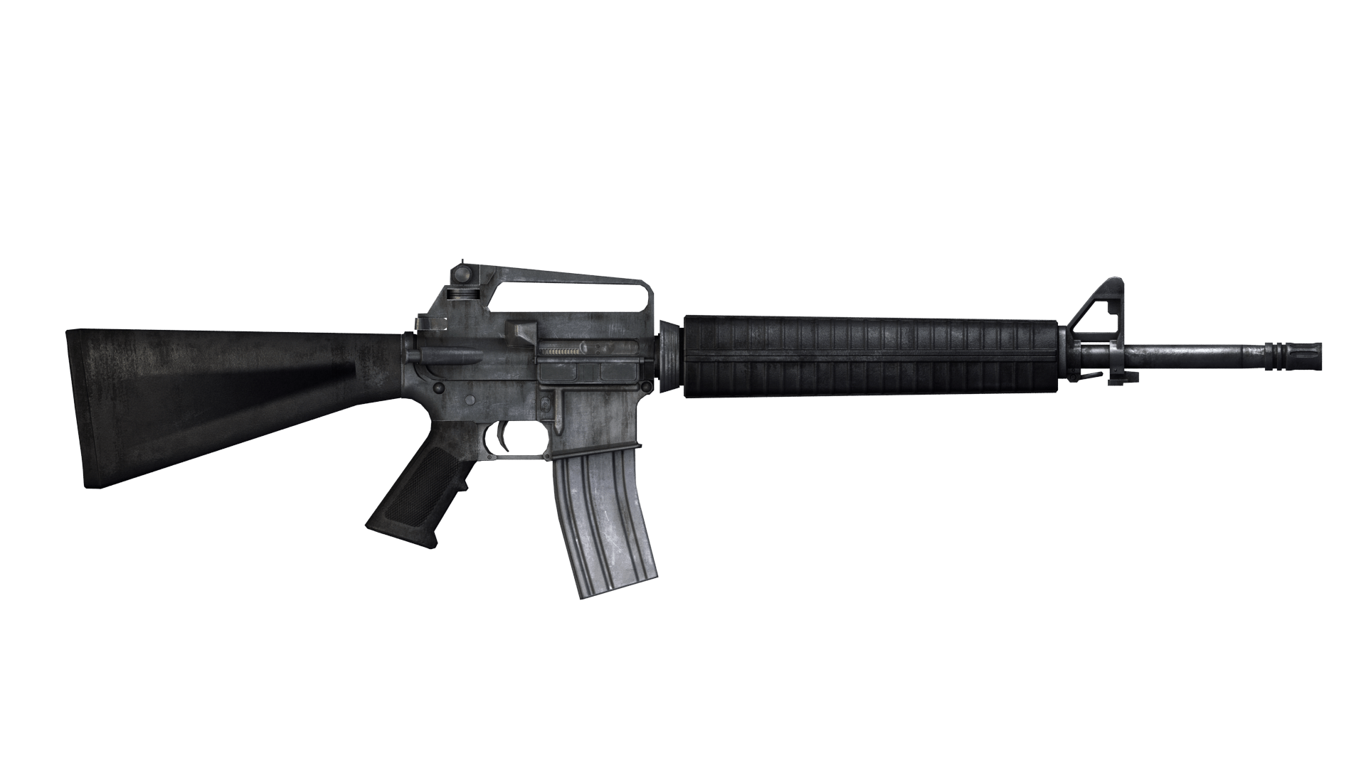
Rifle or Handgun
16”
Rifle

Slide 6
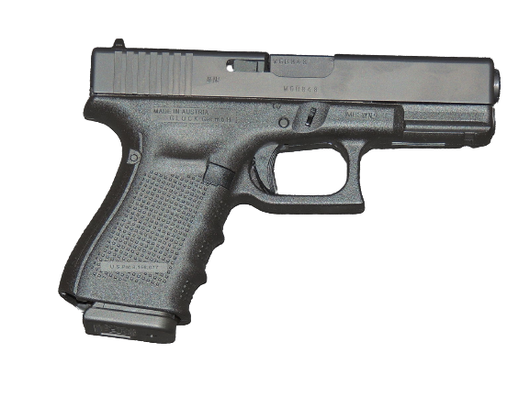
Rifle or Handgun
"Handgun" means any firearm that is designed, made, or adapted to be fired with one hand.

Slide 7
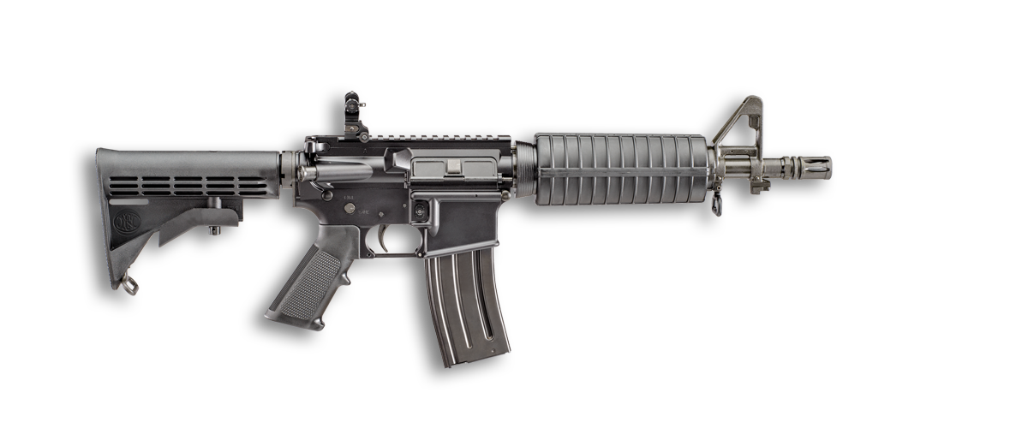
Rifle or Handgun
12”
"Short-barrel firearm" means a rifle with a barrel length of less than 16 inches

Slide 8
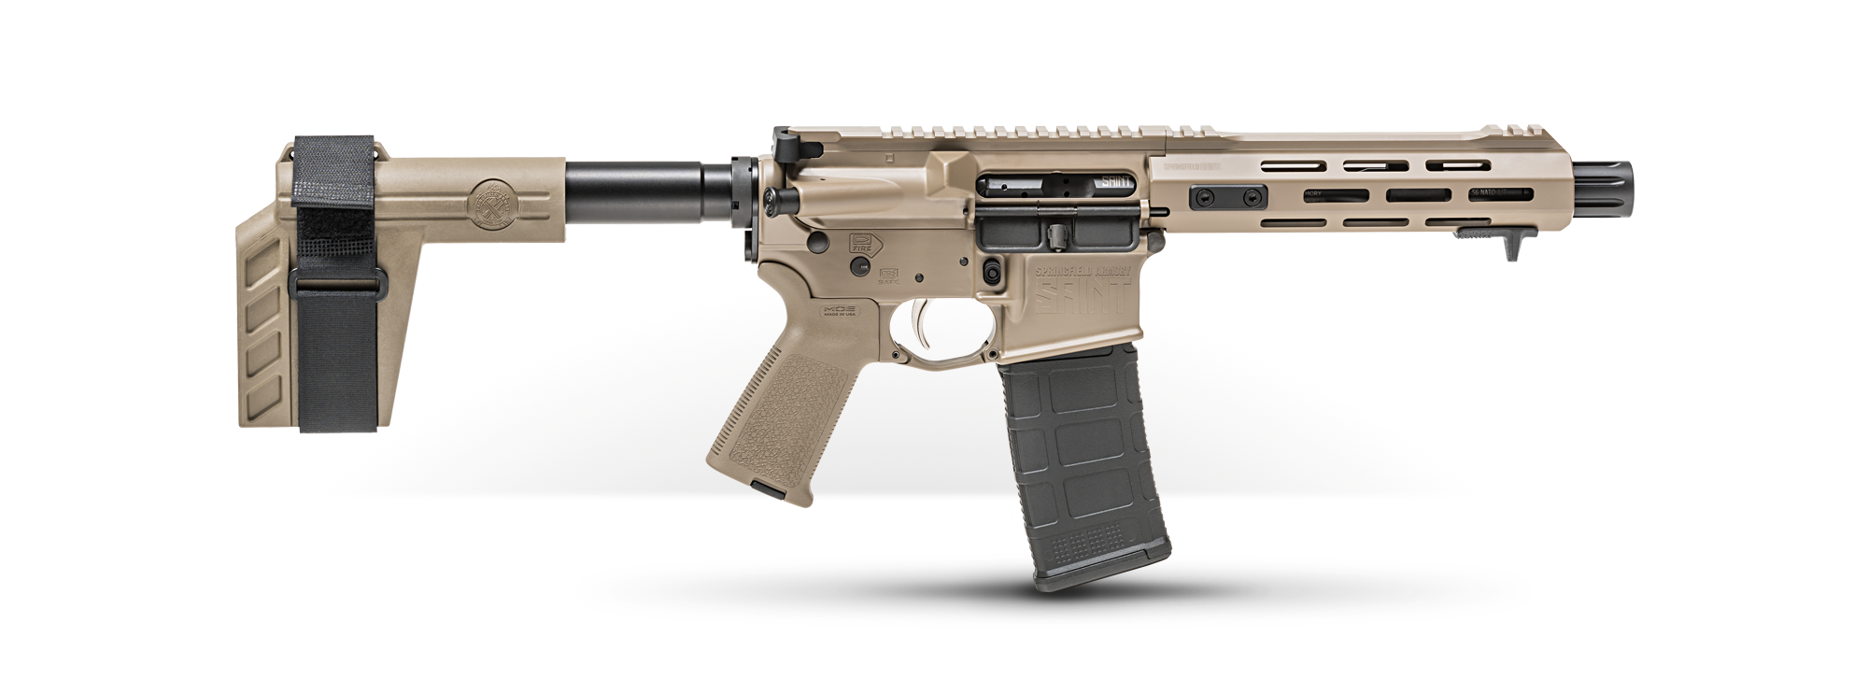
Rifle or Handgun
10”
"Handgun" means any firearm that is designed, made, or adapted to be fired with one hand.

Slide 9
Definitions
Sec. 30.05. CRIMINAL TRESPASS. (a) A person commits an offense if the person enters or remains on or in property of another... without effective consent and the person:
(1) had notice that the entry was forbidden; or
(2) received notice to depart but failed to do so.

Slide 10
Definitions
Sec. 46.01. "Firearm" means any device designed, made, or adapted to expel a projectile through a barrel by using the energy generated by an explosion or burning substance or any device readily convertible to that use.

Slide 11
Who may carry a Handgun in Texas?
Must be 21 years of age or older
Must not be prohibited from possessing a firearm in a public place under Texas Law
Felons: A person who has been convicted of a felony
Convicted of Assault Family Violence (Class A Misdemeanor)
Under certain protective orders
Within the past 5 years, must not be convicted of the following:
Assault Causes Bodily Injury
Deadly Conduct
Terroristic Threat
Disorderly Conduct – Display or Discharge of a Firearm
Does not need to be a resident of Texas
(Penal Code 46.04)

Slide 12
Types of Carry
Concealed Carry
Open Carry
No part of the handgun is visible (printing allowed)
Does not need to be holstered (ie pocket or bag)
Handgun is fully or partially visible
Must be holstered

Slide 13
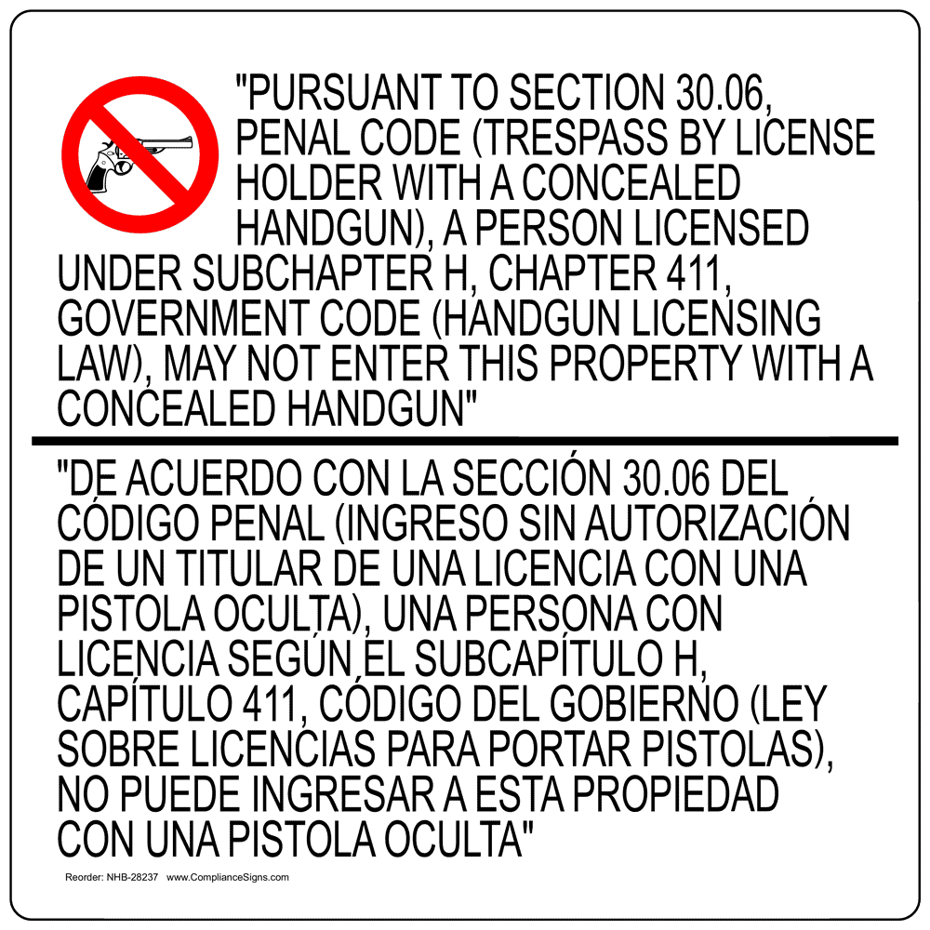
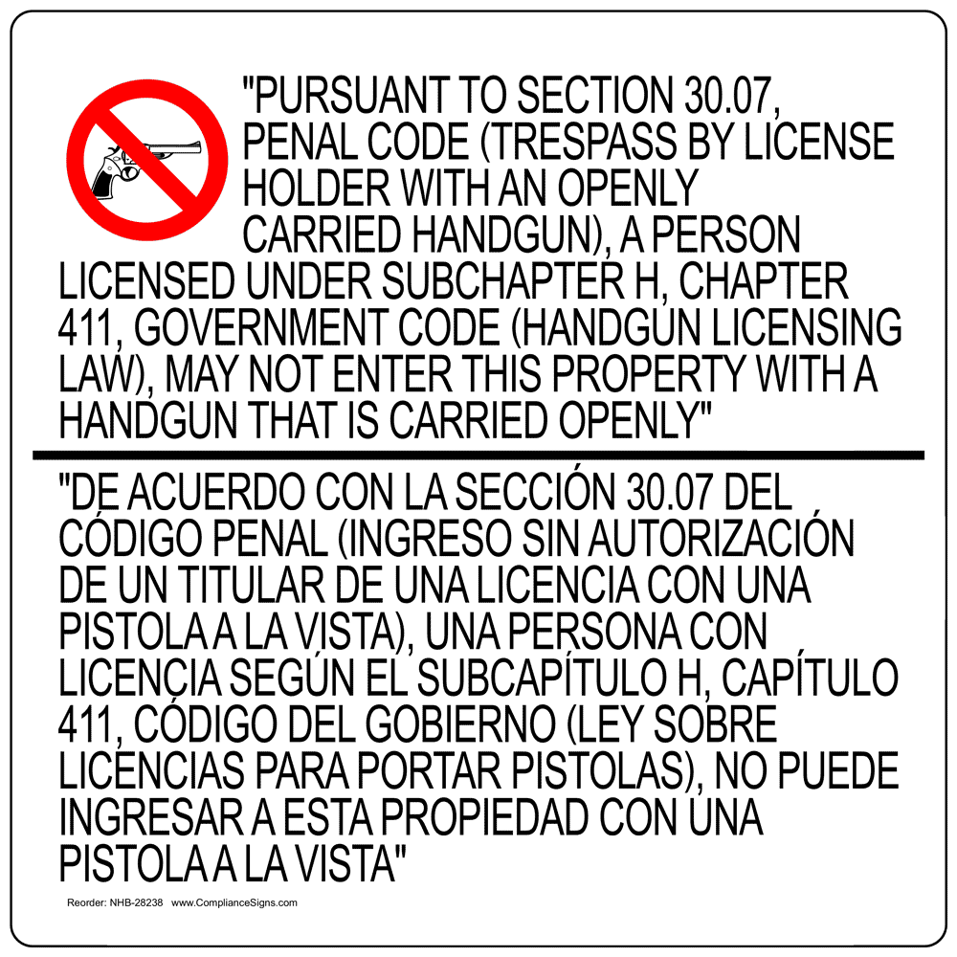
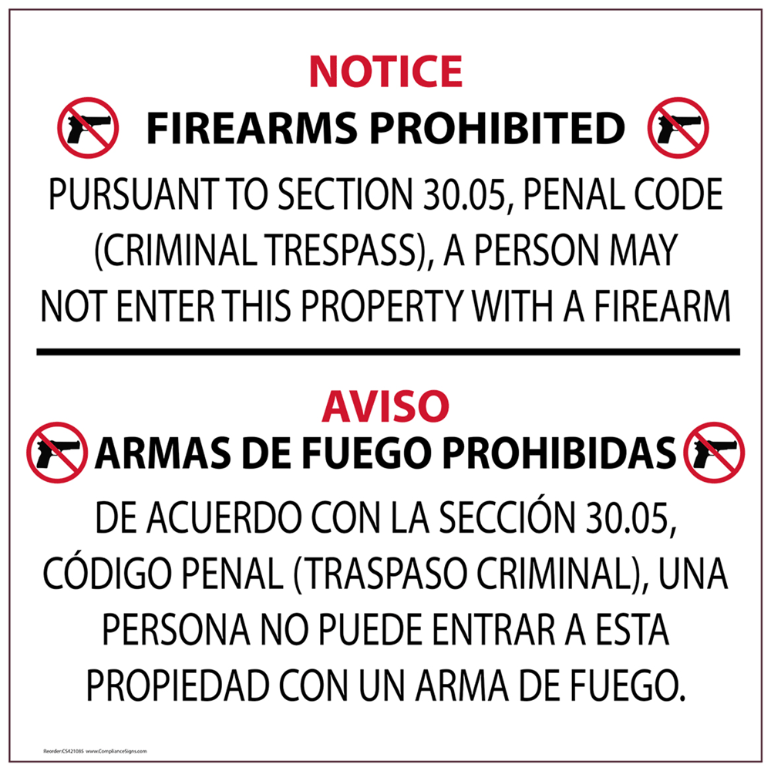
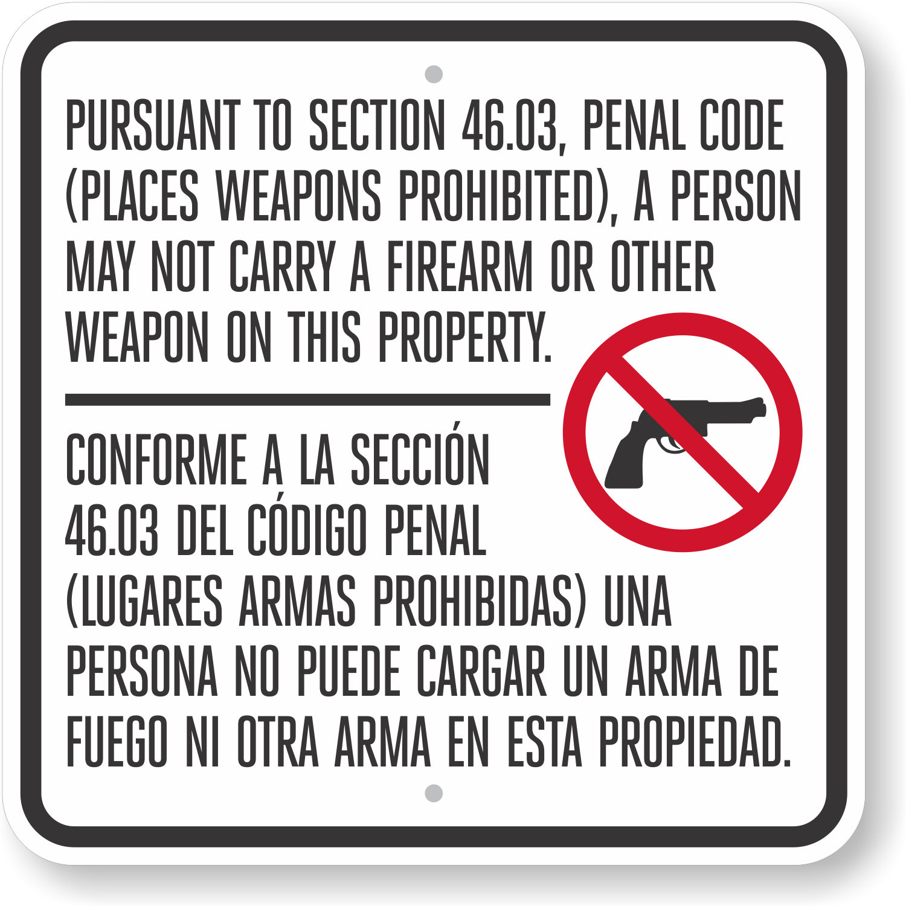
Legal Signage
30.06
30.07
includes language that is identical to or substantially similar to these examples
Must be in English and Spanish
Contrasting Colors
Block Letters at least one inch in height
Displayed in a conspicuous manner clearly visible to the public
An offense under this section is a Class C misdemeanor
30.05
46.03

Slide 14
30.06 Sign
Legally effective against LTC holders
Not Effective against non-LTC holders
Only restricts LTC holders from carrying concealed
Defense to Prosecution:
Leased domicile
Hotels

Slide 15
30.07 Sign
Legally effective against LTC holders
Not Effective against non-LTC holders
Only restricts LTC holders from carrying openly
Defense to Prosecution:
Leased domicile
Hotels

Slide 16
30.05 Sign
Legally effective against all non-LTC holders
Not Effective against LTC holders:
(f) It is a defense to prosecution under this section that:
(1) the basis on which entry on the property or land or in the building was forbidden is that entry with a handgun was forbidden; and
(2) the person was carrying:
(A) a license issued under Subchapter H, Chapter 411, Government Code, to carry a handgun; and
(B) a handgun: in a concealed manner; or in a holster.

Slide 17
46.03 Sign
Effects Licensed & Non Licensed Holders
Schools
Polling places
Courts
Racetracks
Secure area of Airport
1,000’ of a place of execution
Pro sporting events
Correctional facilities
Hospitals
Amusement parks

Slide 18
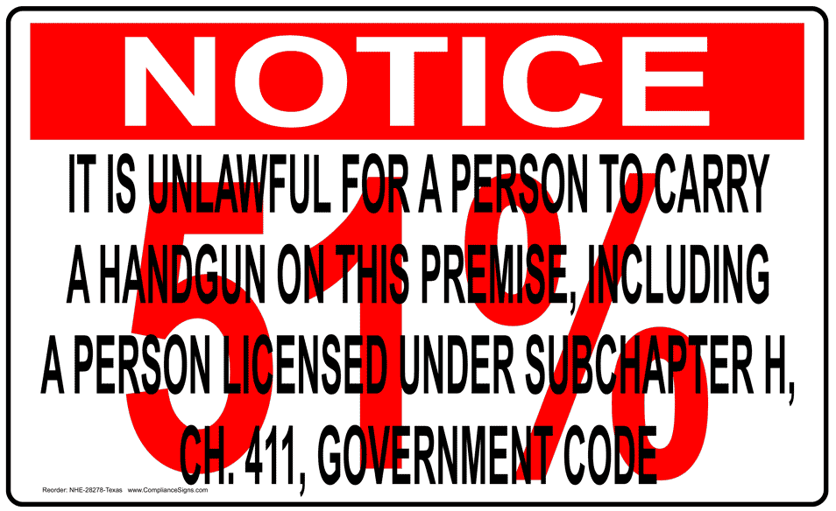
51% Sign
A person, licensed or unlicensed, commits an offense if the person intentionally, knowingly, or recklessly carries a handgun under the authority of Subchapter H, Chapter 411, Government Code, regardless of whether the handgun is concealed or carried in a holster, on or about the license holder's person:
(1) on the premises of a business that has a permit or license issued under Chapter 25, 28, 32, 69, or 74, Alcoholic Beverage Code, if the business derives 51 percent or more of its income from the sale or service of alcoholic beverages for on-premises consumption, as determined by the Texas Alcoholic Beverage Commission under Section 104.06, Alcoholic Beverage Code

Slide 19
Questions?

Slide 20
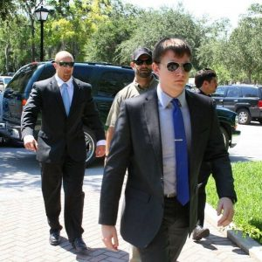
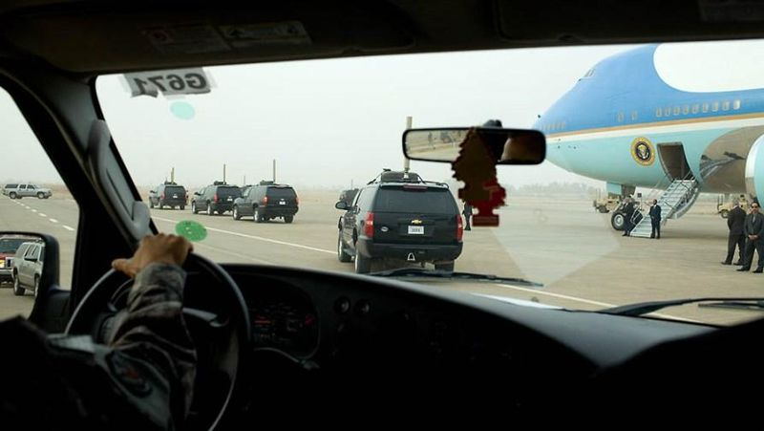
Metropolitan Protection Services, LLC
Thomas J. Franks, President & CEO
www.mpsagency.us
(512) 793-7706

