Slide 1
Immigration Update 2019
Kate Lincoln-Goldfinch
Lincoln Goldfinch Law
Austin & Waco
Call or text: 512.599.8500
www.lincolngoldfinch.com

Slide 2
Outline:
US Immigration History in 4 parts
Asylum and immigration detention
Trump’s invisible wall
Abolish ICE movement
Common misconceptions – get in line, do it the right way, anchor babies
Immigration 101
Practice pointers for family and criminal law attorneys
Questions

Slide 3
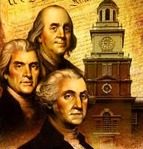
The first wave Through 1850
Immigration pre-restrictions
White
English-speaking
Protestant
Notes:
Wave one:
First immigrants cherished ideals of individual liberty, self-government, religious tolerance, and economic opportunity, founders of a new nation – original immigrants. First subjugated Indians, focused on keeping out criminals deported from Britain and paupers
All white, protestant, mostly English speaking. 90% France, Germany, Ireland, Great Britain. Suspicious of Catholics and Germans.
Framers of the constitution struggled with defining immigration and decided to leave it alone. Let Congress decide naturalization.
Examples of immigration restriction of this era:
Some religious denial – no Catholics in some colonial charters. Virginia is an example and laws against Quakers – example refusal to baptize children.
Prior to the civil war, southern slave states and some norther states Prohibited free blacks
1798 Naturalization Act – 14years for USC, Alien Friends Act authorized deportation of people dangerous to the peace and safety of US, aimed largely at Irish Immigrants and French refugees.

Slide 4
Restrictionism
Why should the Palatine Boors [Germans] be suffered to swarm into our Settlements, and by herding together establish their Language and Manners to the Exclusion of ours? Why should Pennsylvania, founded by the English, become a Colony of Aliens, who will shortly be so numerous as to Germanize us instead of our Anglifying them, and will never adopt our Language or Customs, any more than they can acquire our Complexion.
America as a Land of Opportunity: Benjamin Franklin, 1751
Notes:
Xenophobia Closed Borders Anti-immigrant

Slide 5
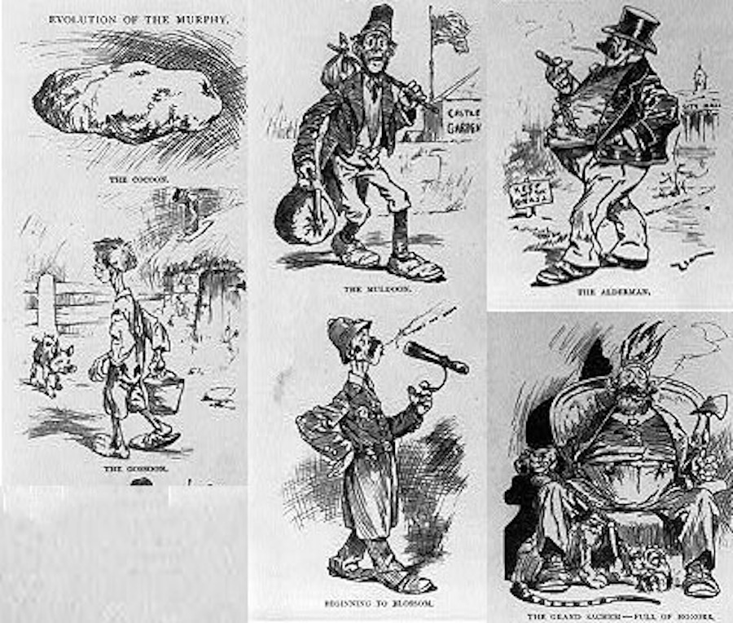
Notes:
In “The Evolution of the Murphy”, an Irish child begins life as a potato, then becomes a vagrant, a cop and finally a corrupt political official

Slide 6
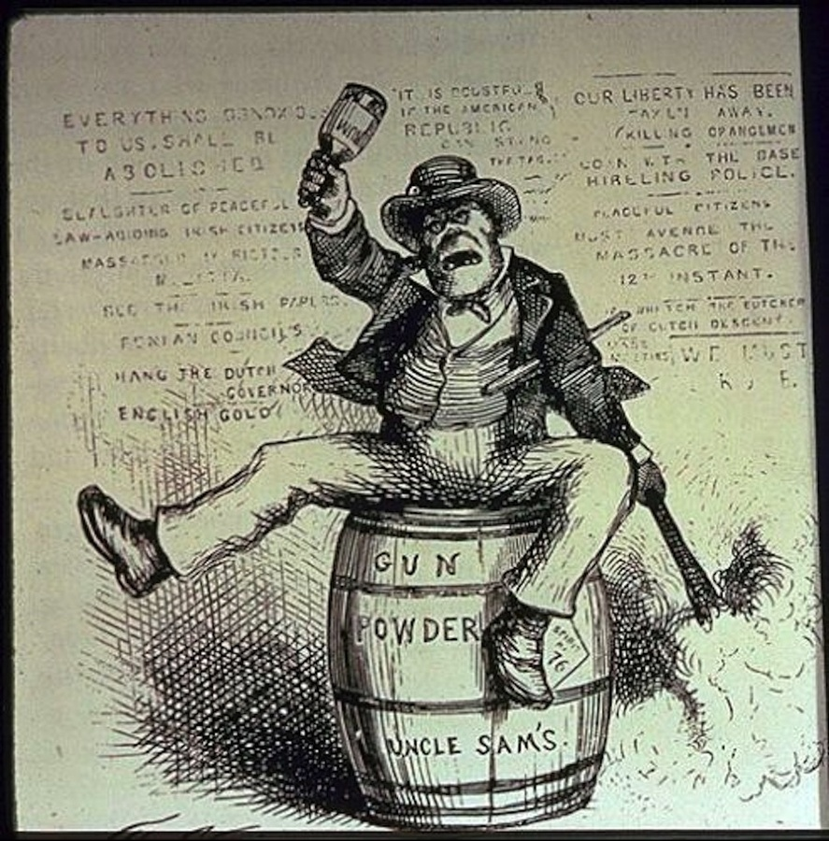
Notes:
Here’s an Irish ape, swinging a bottle of rum, rocking back and forth on a barrel of gunpowder

Slide 7
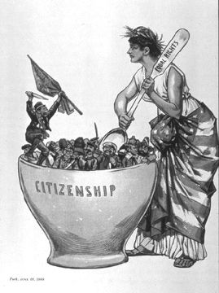
Notes:
The undesirable Irish unmixable in the National Pot

Slide 8
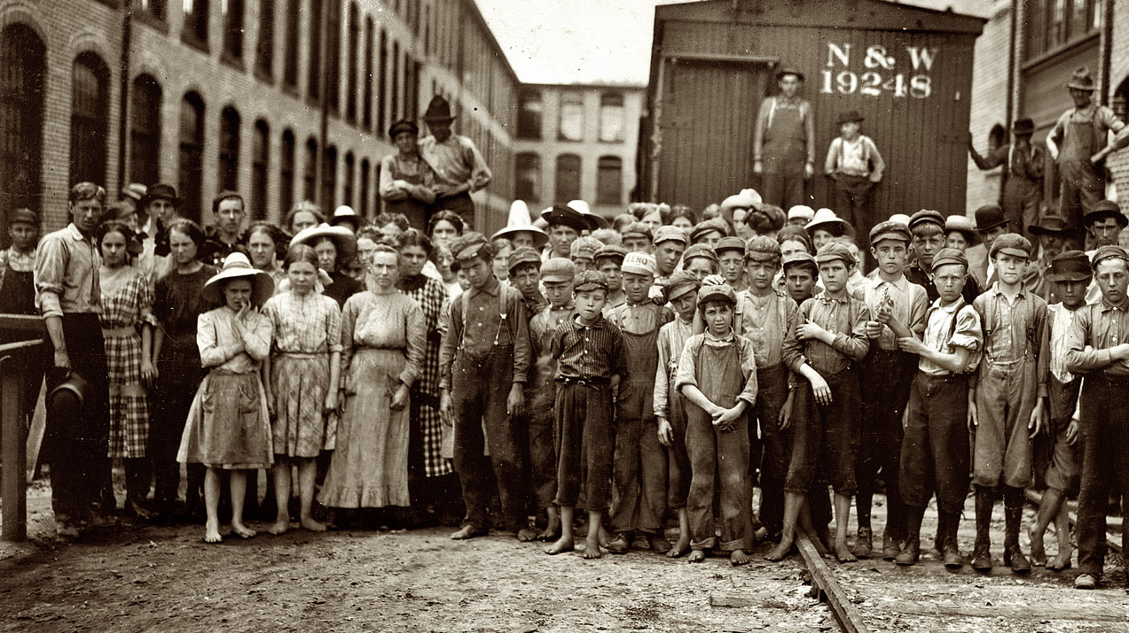
Wave Two 1850-1920
More diverse
Catholics
Jews
Southern Europeans
Non-English speakers
Notes:
Between 1880 and 1920, a time of rapid industrialization and urbanization, America received more than 20 million immigrants. Beginning in the 1890s, the majority of arrivals were from Central, Eastern and Southern Europe. Italians and Jews came in large numbers.
First comprehensive federal immigration law in 1864 was an Act to Encourage Immigration. Established the first US Immigration Bureau whose primary function was to increase immigration so that American industries would have an adequate supply of workers to meet production needs during the Civil War.
Potato famine 1840-1860 87.5% of immigrants from Ireland, Germany, Great Britain. Half a million people died.

Slide 9
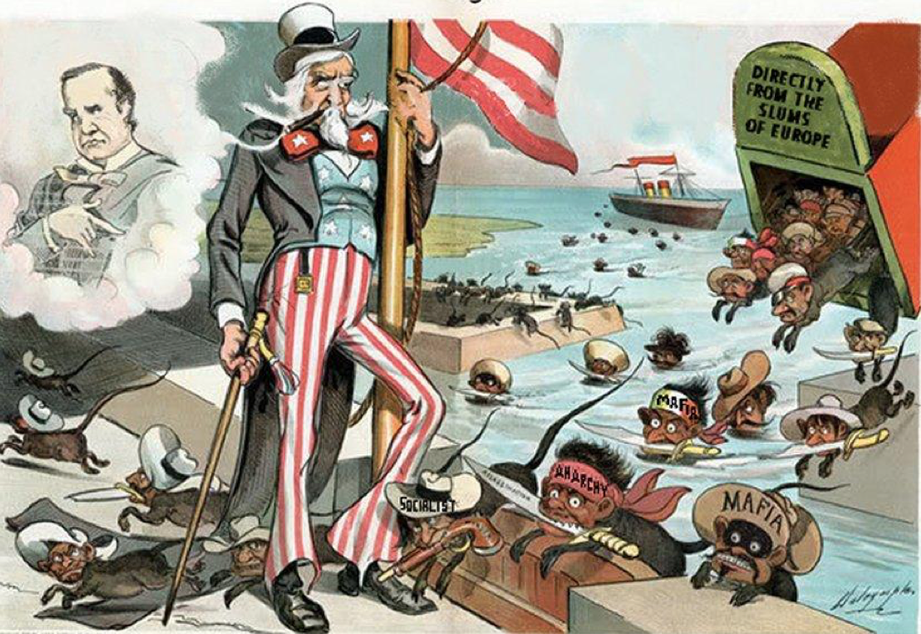
Notes:
President McKinley (top left) believed in open immigration. Here’s Uncle Sam, at his direction, looking on as Italian rats “directly from the slums of Europe” pour into the country. Sound / look familiar?
Know nothing: Alien menace of the Irish Catholics. Several groups form the Order of Star Spangled Banner which adopted a pledge of secrecy. If asked, responded “I know nothing.” Most powerful nativist organization of the era –the know nothing party. Protestantism preserved the republic b/c it emphasized individualism, democracy, equality while Catholicism threatened the republic b/c stressed authoritarianism, opposed freedom of thought, dictated how Catholics should vote

Slide 10
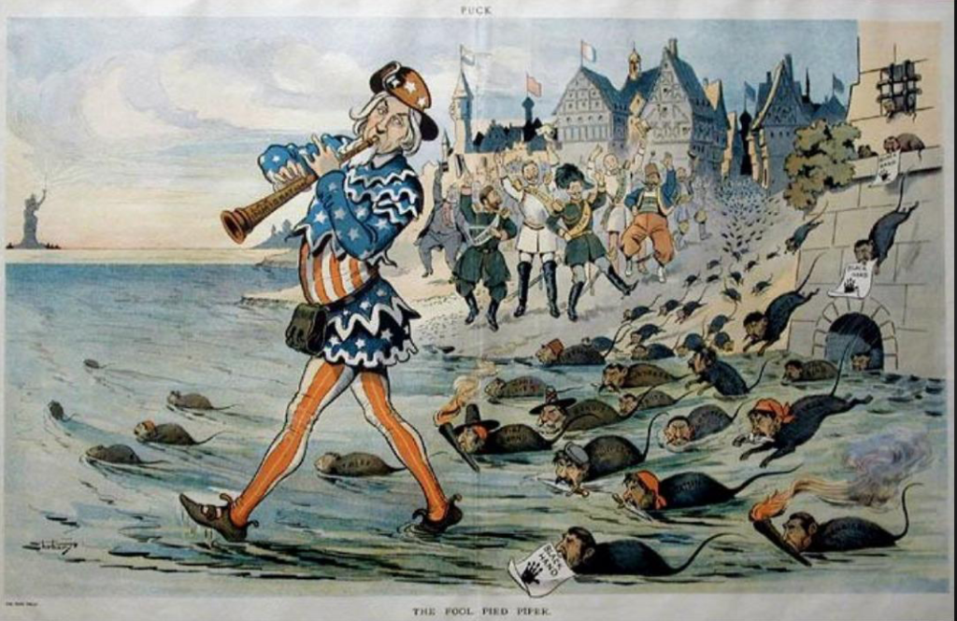
Notes:
The American “fool pied piper” leads more Italian rats toward Ellis Island as the cheering European aristocracy rejoices in the background. You can imagine some demagogue back then saying “they’re sending us their worst people”, can’t you?
14.5 million immigrants enter in 1900-1920: 60% Italy, Austria, Hungary, and Soviet Union

Slide 11
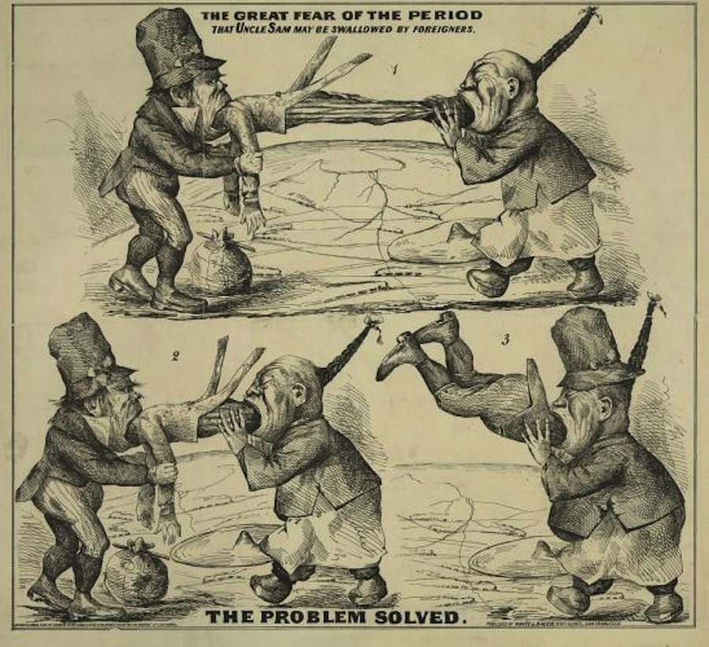
1882 Chinese Exclusion Act
Banned all Chinese laborers
Notes:
1882 Chinese Exclusion Act
Here’s Uncle Sam being swallowed by Chinese and Irish immigrants, many of whom came over in the mid-1800’s to work on the railroads & gold discovery
Depression of 1873 - Moral rhetoric suggesting nation had a responsibility to provide first for its own citizens and its own race. Depression in 1873 and Chinese were the scapegoats.

Slide 12
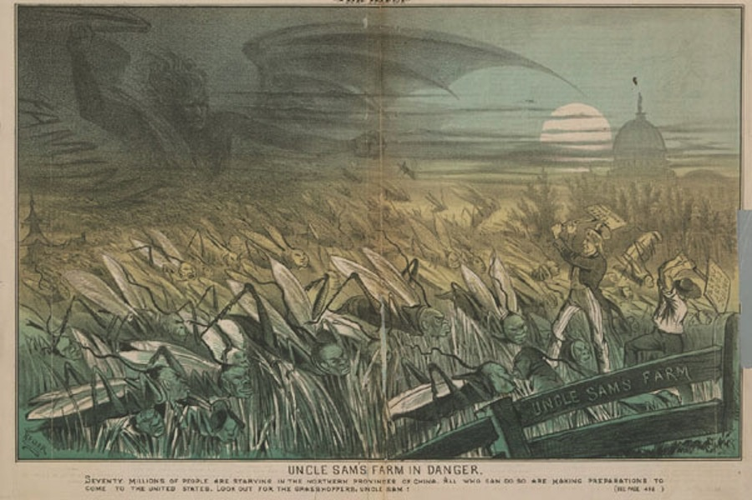
Notes:
Here are Chinese locusts infesting America.
Ordinance about laundries in brick or stone building only. Yick Wo v. Hopkins 1886 “Though the law itself be air on its face and impartial in appearance, yet, if it is applied and administered by public authority with an evil eye and an unequal hand, so as practically to make unjust and illegal discriminations between persons in similar circumstances, material to their rights, the denial of equal justice is still within the prohibition of the constitution.”
Chinese exclusion act excluded laborers for ten years. Chinese women defined as laborers- immigrants had no way to bring their wives or children.

Slide 13
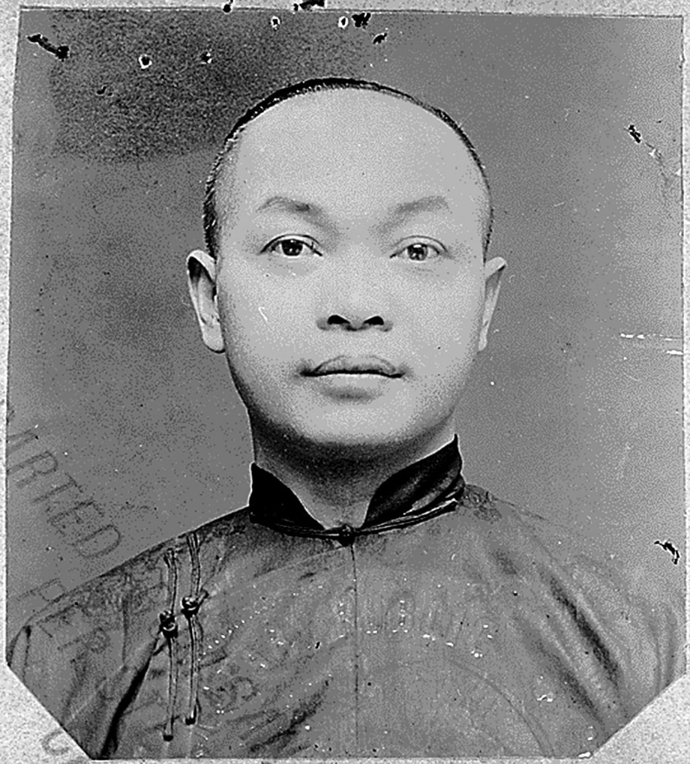
Wong Kim Ark
The first test case of the 14th Amendment birthright citizenship – Wong Kim Ark
Notes:
Wong Kim Ark gives us birthright citizenship
14th “All persons born or naturalized in the United States, and subject to the jurisdiction thereof, are citizens of the United States and of the state wherein they reside.”
SCOTUS holding: “to hold that the Fourteenth Amendment of the Constitution excludes from citizenship the children, born in the United States, of citizens or subjects of other countries would be to deny citizenship to thousands of persons of English, Scotch, Irish, German, or other European parentage who have always been considered and treated as citizens of the United States.”

Slide 14
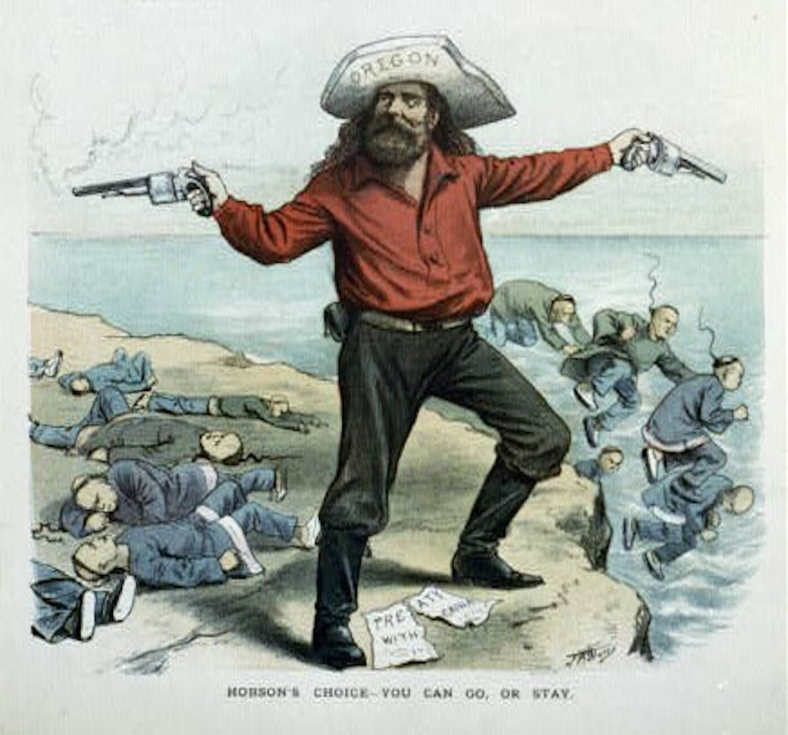
Notes:
Here’s an Oregonian settler offering a choice to the Chinamen who were inhabiting the west when he arrived – you can go or stay

Slide 15
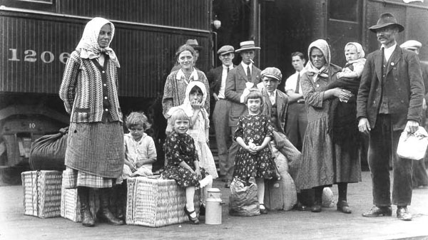
Phase Three 1920-1965
1900-1910 brings largest influx of immigrants to the US to date
Restrictions of 1920 drastically reduce diversity through 1965
Notes:
1900-1910 largest influx of immigrants to the US. More Catholics from Ireland and Jews from Germany. Italians and Jews were commonly distinguishable and suffered the most resentment.
Jews and Italians not welcomed.
Eugenics movement was in full swing, scientific hierarchy with those of Nordic descent at the zenith.
Restrictionists start to gain power.

Slide 16
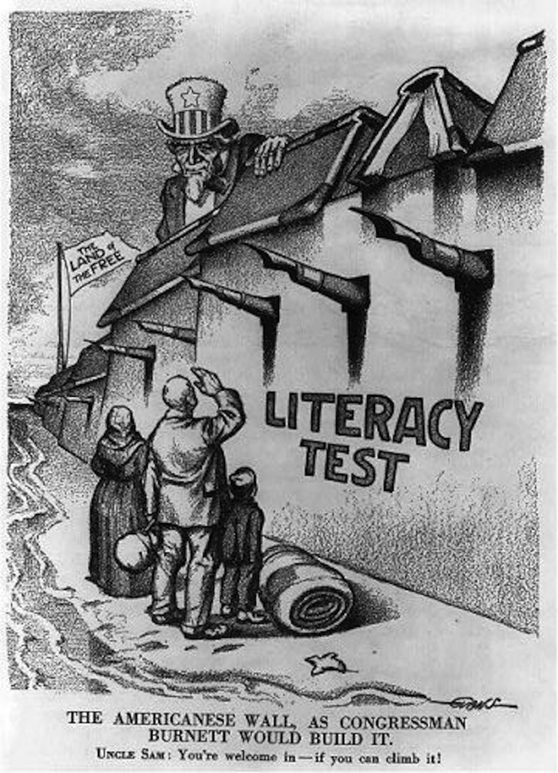
Notes:
Immigration act of 1917 required all aliens over sixteen years old to be able to read English or some other language or dialect. Aimed at southern and Eastern Europeans.
Congress had passed such a requirement four times since the 1890’s but Presidents Cleveland, Taft, and Wilson had vetoed it, believing it was contrary to the principle of individual selection. Congress finally passed it in 1917 only by overriding Wilson’s second veto. Strong antiradical current also ran through postwar nativism, which associated Jews with Bolshevism and Italians with anarchism.
Legislation wasn’t easing back then

Slide 17
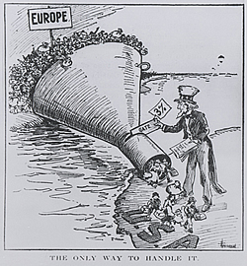
1924 National Origins Quota Act
Quotas allocated to countries in the same proportion that the American people traced their origins
Excluded Africans, African-Americans, mixed race, Chinese, Japanese, Indian, and other Asian on the ground that they were racially ineligible for naturalized citizenship
Generated illegal immigration
The whitening of American
Notes:
Congress legislated first numerical restrictions in 1921 but it would be nearly a decade before permanent immigration quotas were implemented. Intervening years were filled with contention and difficulty as Congress debated the design of the new system.
1924 National 0rigin Quota Act
Permanent system of quotas: quotas were allocated to countries in the same proportion that the American people traced their origins to those geographical areas, through immigration or the immigration of their forbears. Discounted black and mulatto, Chinese, Japanese, Asian and South Asian, excluded Hawaii, Puerto Rico, and Alaska. The law excised all nonwhite, non-European peoples from that vision, erasing them from American nationality.
First comprehensive restriction law. Favored some immigrants over others and created hierarchies of difference.
Exempted Mexico and other countries of the Western Hemisphere from numerical quotas. Mexicans were welcome b/c it was thought they were temporary.
Excluded Chinese, Japanese, Indians and other Asians on the ground that they were racially ineligible for naturalized citizenship.
Placed numerical limits on immigration and established a quota system that classified the world’s population according to nationality and race, ranking them in a hierarchy of desirability for admission into the United States.
Generated illegal immigration. Immigration was unrestricted before this

Slide 18
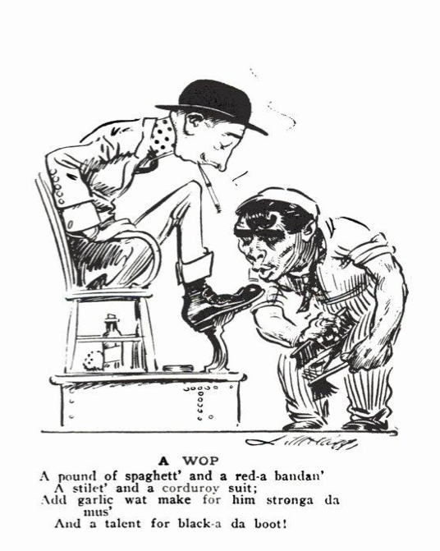
Notes:
An Italian with the features of a monkey shines the shoes of a dandy. Southern Italians in particular were looked down upon for being “not quite white

Slide 19
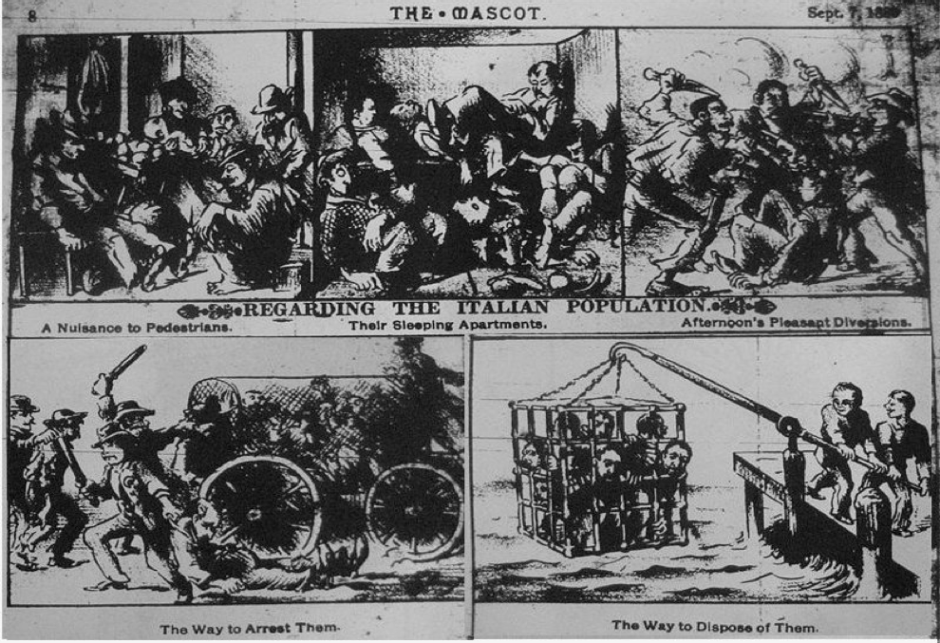
Notes:
The first mass migration of Italians were the Sicilians – many of whom first arrived in New Orleans. It was said that Roman Catholics could never be real Americans because their loyalty would always be first and foremost to the church. There were conspiracy theories that they were planning to set up a Papal State within the US. Below is a casual instruction manual to deal with their kind and drown them like rats:

Slide 20
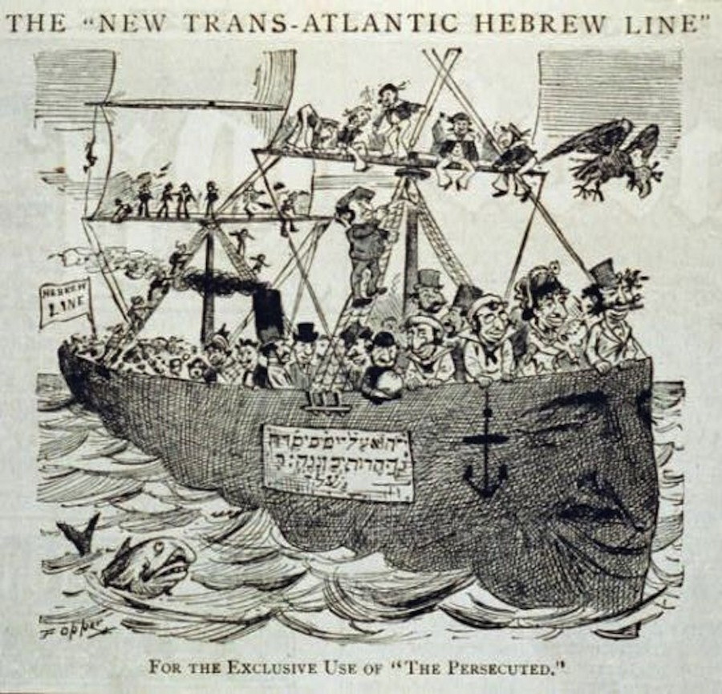
Notes:
A ship filled with big-nosed Jews, being ridiculed for fleeing the pogroms and sporadic outbursts of homicidal rioting against them across Russia and Eastern Europe. You’ll notice the ship itself is given a giant Jew nose for a prow, nice touch

Slide 21
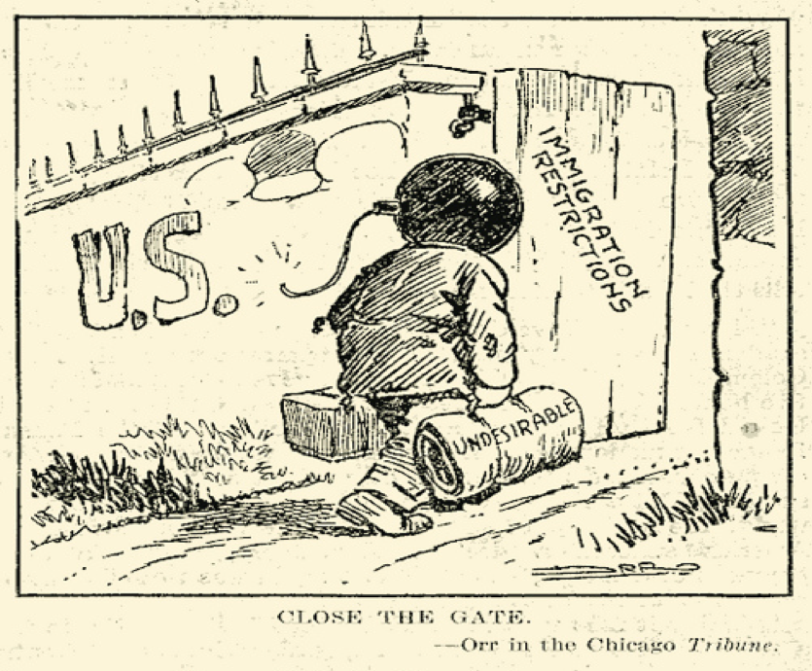
Notes:
“Close the Gate” from 1919 – immigrants were routinely depicted as “Reds”, communists, Marxists and anarchists by this time – the irony being that these were some of the very things they were fleeing from. Not unlike the Middle Easterners currently fleeing from the very terrorism and religious genocide that many are accusing them of supporting:

Slide 22
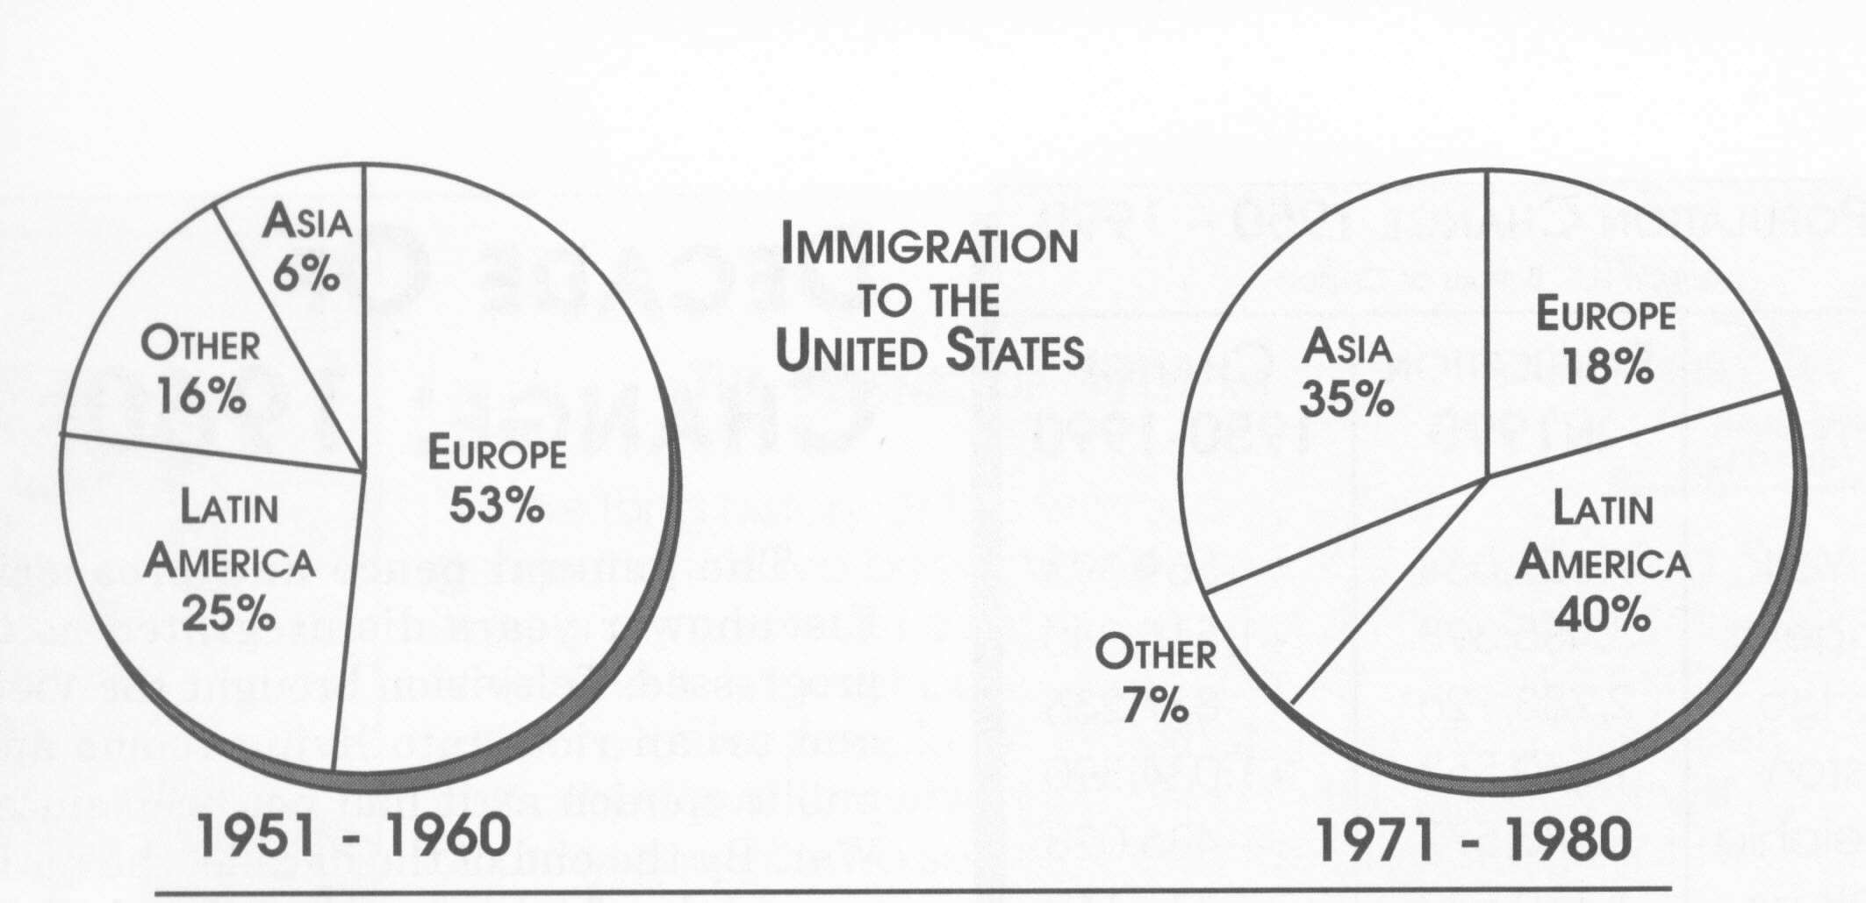
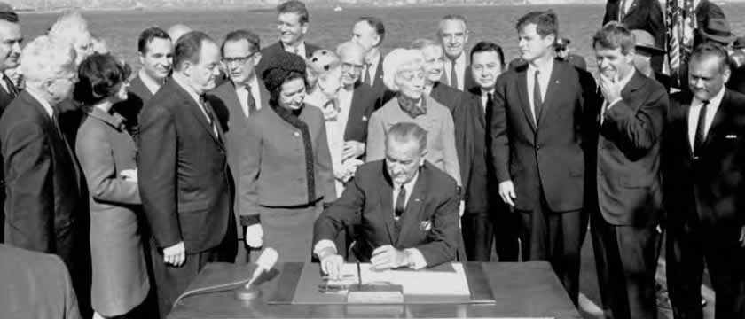
Phase Four Post 1965
Immigration Act of 1965
Eliminated racial and national origins quotas
Established Western and Eastern Hemisphere Quotas
Immigration diversifies
Notes:
1965 Amendments
Eliminated racial and national origins quotas
Established Western and Eastern Hemisphere quotas
The historic significance of the 1965 law was to repeal national-origins quotas, in place since the 1920s, which had ensured that immigration to the United States was primarily reserved for European immigrants. Building on a campaign promise by President Kennedy, and with a strong push by President Johnson amid the enactment of other major civil-rights legislation, the 1965 law abolished the national-origins quota system.
As a result of this act and subsequent legislation, the nation experienced a shift in immigration patterns. Today, the majority of U.S. immigrants come from Asia and Latin America rather than Europe.
It was replaced with a preference system based on immigrants’ family relationships with U.S. citizens or legal permanent residents and, to a lesser degree, their skills. The law placed an annual cap of 170,000 visas for immigrants from the Eastern Hemisphere, with no single country allowed more than 20,000 visas, and for the first time established a cap of 120,000 visas for immigrants from the Western Hemisphere. Three-fourths of admissions were reserved for those arriving in family categories. Immediate relatives (spouses, minor children, and parents of adult U.S. citizens) were exempt from the caps; 24 percent of family visas were assigned to siblings of U.S. citizens. In 1976, the 20,000 per county limit was applied to the Western Hemisphere. And in 1978, a worldwide immigrant visa quota was set at 290,000.

Slide 23
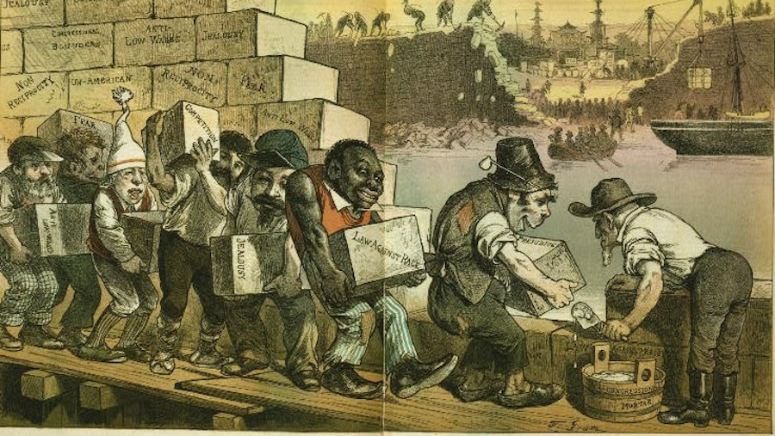
What is an American?
Notes:
Why talk about this? Two reasons: show repeat rhetoric and show what happens when restrictionists pass laws
The irony of a country built by immigrants building walls to keep out specific types of immigrants should be lost on no one. Here you see a former African slave, a Civil War vet, another Irish ape, a Frenchman and a Jew building a wall to keep out whatever might come in behind them:
Tug of war has been constant ever since the founding of our nation. We are in a period of restriction. Hopefully no legislation will pass. But it is comforting to me to view this through the arc of history.

Slide 24
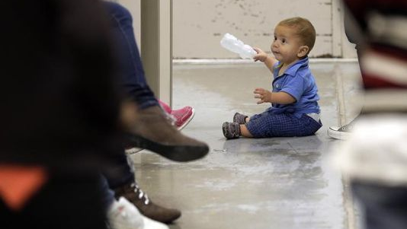
DETENTION OF ASYLUM SEEKERS part one
International failure during WWII to protect Jewish refugees of the Holocaust
Asylum History: 1951 UN Convention, 1967 UN protocol, US Refugee Act of 1980, Expedited Removal in 1996
Central American crisis of the 1980’s and the American Baptist Church lawsuit
Expedited removal in 1996, use of private prison companies and private prison lobby (bed mandate, drafting laws like SB 1070)
Family detention
Notes:
Asylum history
Detention
$150 for adult
$300 for family
Tent cities $775
ATDs .70 cents per day
3 billion or 8 million per day
Bed mandate of 40,000 per day
Family Case Management program: 100 percent in court, 99 percent at ICE check ins, ended by Trump in June. 23 of 954 were “absconders”
Lobby: 2.5 million, drafted legislation at TX Leg, GEO Group hosted leadership conference at Trump resort, hundreds of thousands of dollars to Trump, stocks soared after his election

Slide 25
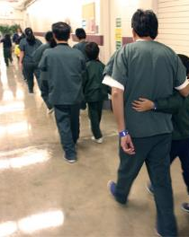
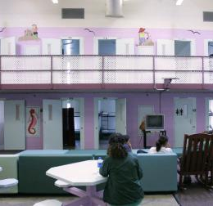
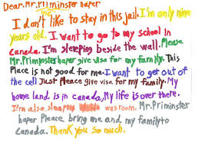
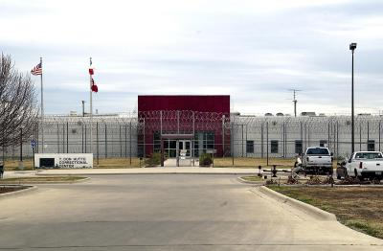
HUTTO

Slide 26
DETENTION OF ASYLUM SEEKERS part ii
Rise in violence in the northern triangle of Central America
Obama passes DACA but is tough on border enforcement
Family Detention in 2014
Notes:
Asylum history
Detention
$150 for adult
$300 for family
Tent cities $775
ATDs .70 cents per day
3 billion or 8 million per day
Bed mandate of 40,000 per day
Family Case Management program: 100 percent in court, 99 percent at ICE check ins, ended by Trump in June. 23 of 954 were “absconders”
Lobby: 2.5 million, drafted legislation at TX Leg, GEO Group hosted leadership conference at Trump resort, hundreds of thousands of dollars to Trump, stocks soared after his election

Slide 27
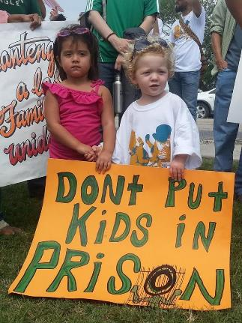
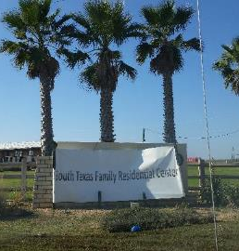
Dilley
2400 mothers and children
Controlled by ICE, Operated by CoreCivic Group

Slide 28
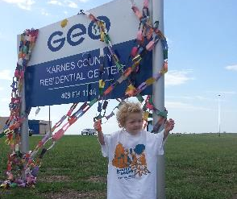
Karnes
Capacity 1,100
54 miles SE of San Antonio
Controlled by ICE, Operated by GEO Group
Notes:
When opened, population, and numbers, SA courts

Slide 29
DETENTION OF ASYLUM SEEKERS part iii
Turnbacks and Metering
Family Separations
Migrant Caravan
Government shutdown for Wall funding
Notes:
Asylum history
Detention
$150 for adult
$300 for family
Tent cities $775
ATDs .70 cents per day
3 billion or 8 million per day
Bed mandate of 40,000 per day
Family Case Management program: 100 percent in court, 99 percent at ICE check ins, ended by Trump in June. 23 of 954 were “absconders”
Lobby: 2.5 million, drafted legislation at TX Leg, GEO Group hosted leadership conference at Trump resort, hundreds of thousands of dollars to Trump, stocks soared after his election

Slide 30
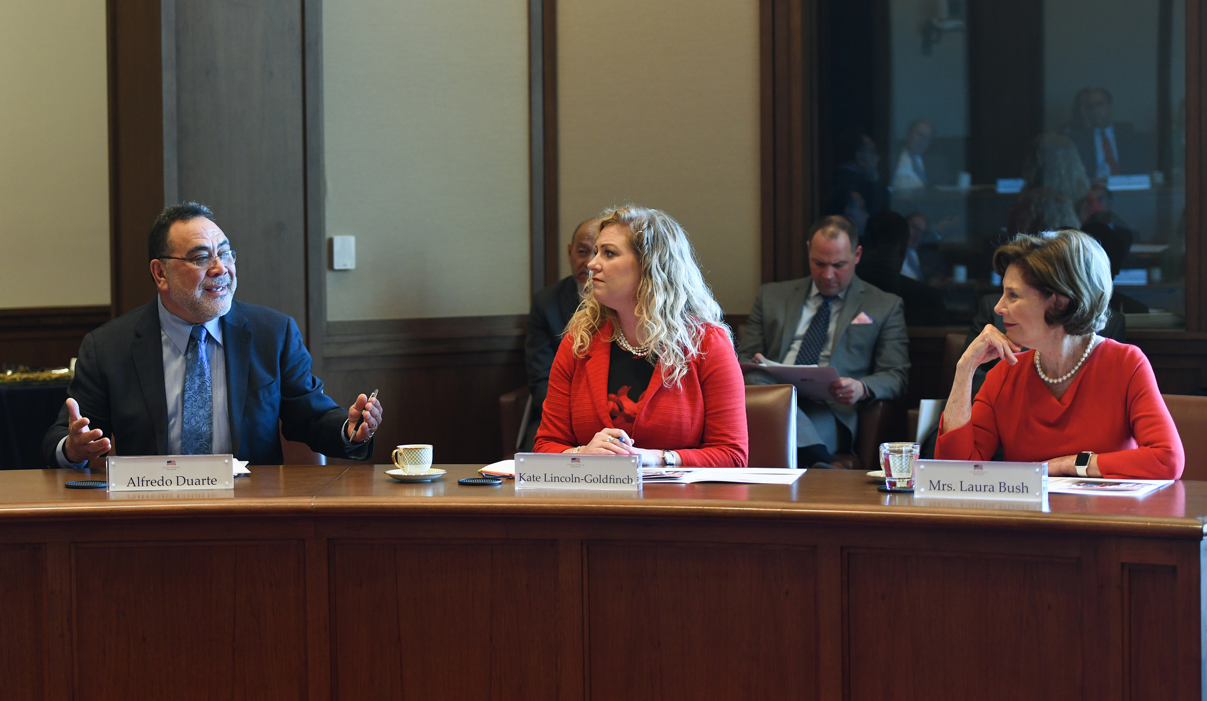
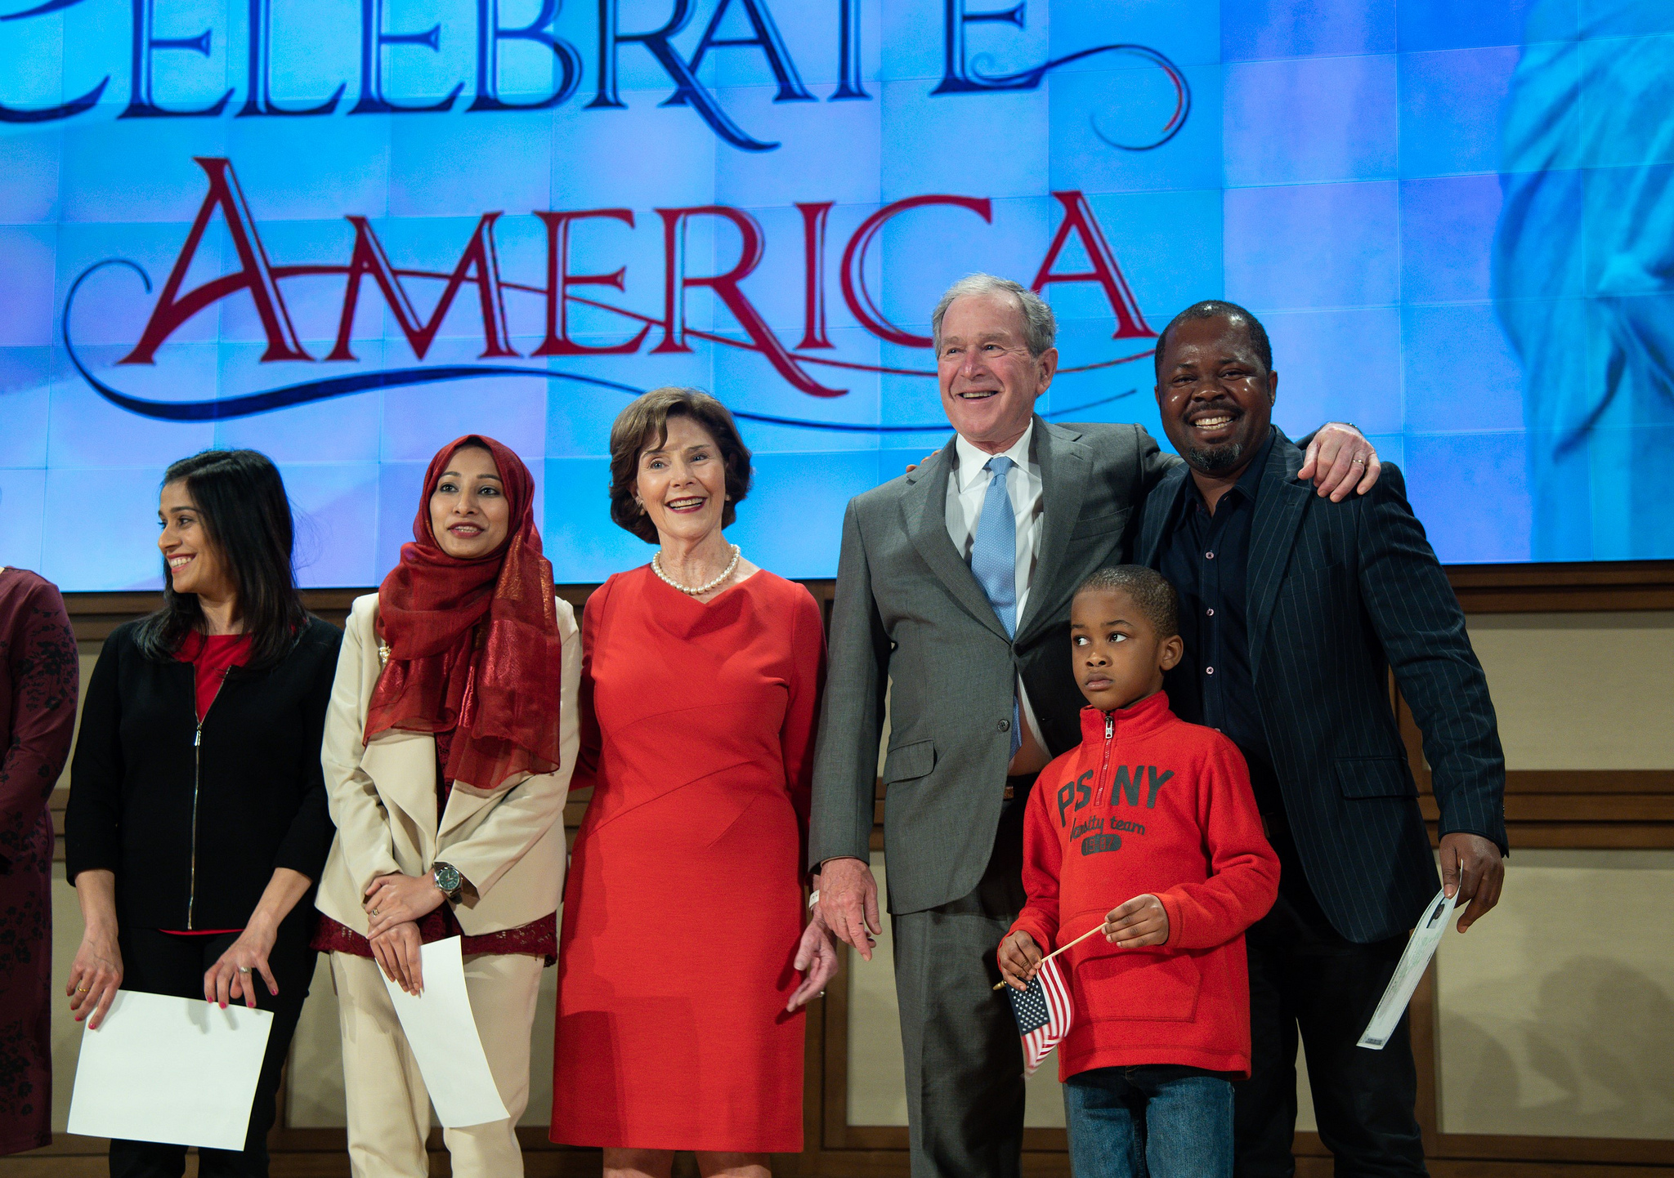
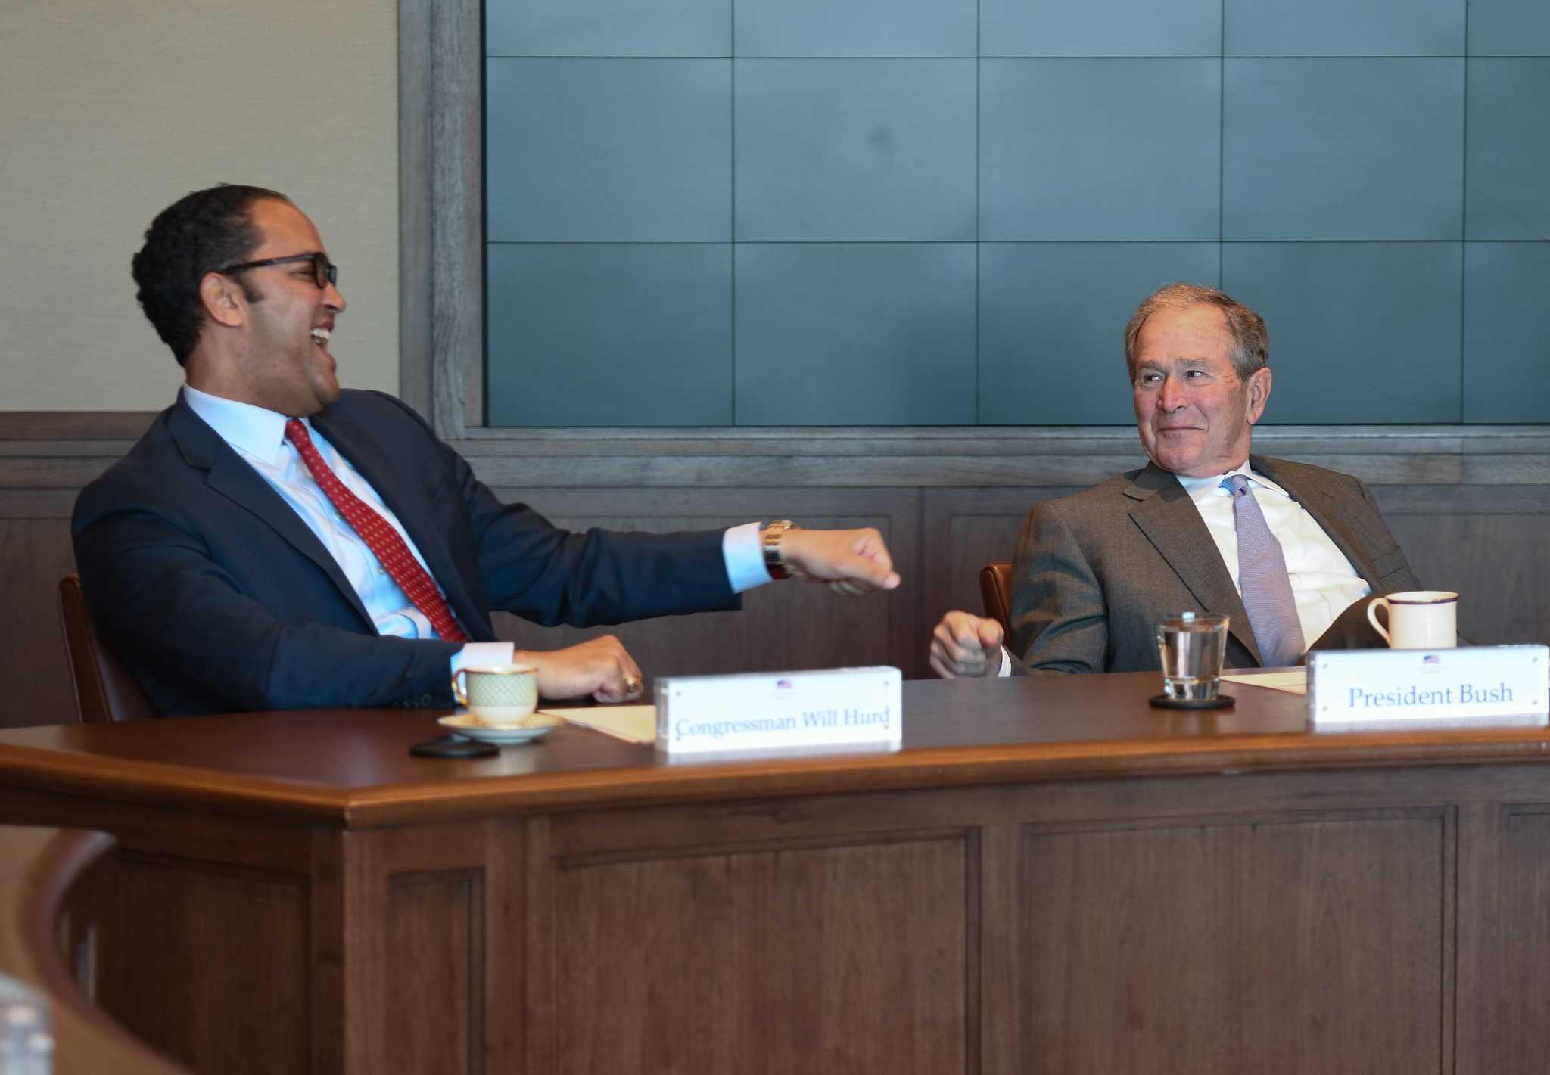
What do we do? Bush Institute March 18, 2019
Notes:
Talk about my experience
Border patrol officers

Slide 31
INVISIBLE WALL
Notes:
PROCESSING TIMES
RFE MEMO
NTA MEMO
Court Backlog 700,000
DACA
TPS
2 year naturalization
Public charge
MAVNI: Military Accessions Vital to National Interest

Slide 32
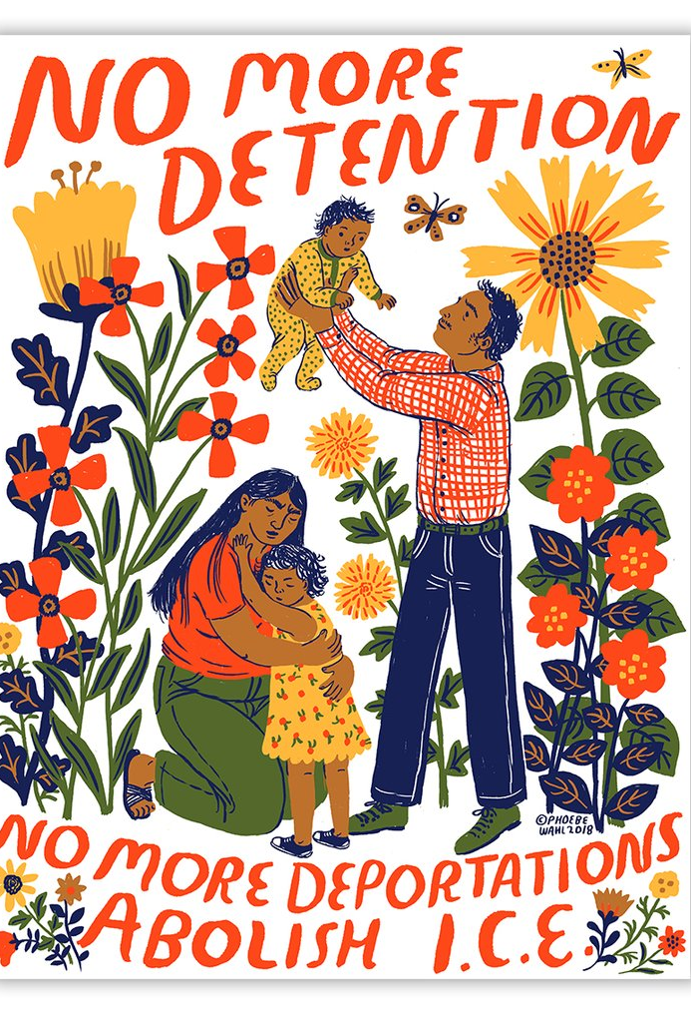
ABOLISH ICE – what does that mean?
Checks and Balances, three branches
Immigration Court
Jeff Sessions
Notes:
Migrant caravan
Civics lesson: congress makes laws, exec carries out the laws, judiciary applies in individual cases
Matter of AB – Dicta – in general, a victim of private violence does not qualify for asylum. Applied by asylum officers

Slide 33
MYTH: CHAIN MIGRATION
Family- Sponsored | All Chargeability Areas Except Those Listed | CHINA-mainland born | INDIA | MEXICO | PHILIPPINES
F1 | 22OCT11 | 22OCT11 | 22OCT11 | 01AUG97 | 01APR07
F2A | 08JAN17 | 08JAN17 | 08JAN17 | 15DEC16 | 08JAN17
F2B | 01AUG12 | 01AUG12 | 01AUG12 | 22SEP97 | 22JUL07
F3 | 08SEP06 | 08SEP06 | 08SEP06 | 15JAN96 | 01JAN96
F4 | 22SEP05 | 22SEP05 | 08JUL04 | 08FEB98 | 01JAN96
3.9 million family members wait in line
March 2019 Visa Bulletin - Current wait times
Notes:
F4 Mexico May 22 1997, moved six months so backlogged 40 years
F4 al countries Feb 2004 – 56 years
F1 one year
F2b one year

Slide 34
Myth: anchor baby
Kids have to be 21 to petition parent
Qualifying relative for waiver
Spouse
Parent
NOT child

Slide 35
Types of Immigrants
CITIZENS
Birthright citizenship Acquired/Derived
Naturalization
NON-CITIZENS
immigrants
lawful permanent residents (LPRs) “greencard”
Conditional residents
Refugees/asylees
Diversity visa
non-immigrants
Visitors
Students
temporary workers
Alphabet soup of visas
DACA/TPS
undocumented
Notes:
The basics
Birthright – 14th Amendment, acquired, derived, naturalization
Immigrant: diff b/w refugee and asylee
Nonimmigrant
Undoc – overstay and EWI
Agencies:
DHS, CBP, ICE, EOIR - no right to govt appointed counsel b/c “civil”

Slide 36
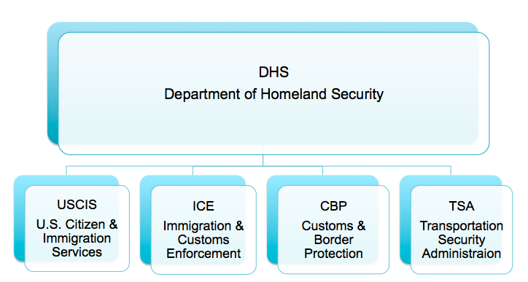
Understanding Relevant Agencies
CBP: Customs and Border Protection
ICE: Immigration and Customs Enforcement
USCIS: United States Citizenship and Immigration Service
DHS: Department of Homeland Security
INS: Immigration and Naturalization Service, not in existence
EOIR: Executive Office for Immigration Review
Notes:
HHS and ORR up to 18

Slide 37
Practice Pointers - Family
Divorce - when to refer to an immigration lawyer
I-864 is a legally enforceable contract
VAWA and U visa
Adoption
Notes:
How juveniles get picked up by ICE:
- At any point, during counsel and release with probation officer, after adjudication, upon release, biometrics at juvenile facility
- Adjudication → immigration consequences, better to dismiss
- release to family vs. ORR
- “it is a conviction”
- Will interview even if < 14

Slide 38
Practice Pointers - Criminal
Padilla v. Kentucky, 130 S. Ct. 1473 (2010)
Chaidez v. U.S. (U.S. 2013) – Padilla not retroactive
Notes:
How juveniles get picked up by ICE:
- At any point, during counsel and release with probation officer, after adjudication, upon release, biometrics at juvenile facility
- Adjudication → immigration consequences, better to dismiss
- release to family vs. ORR
- “it is a conviction”
- Will interview even if < 14

Slide 39
Practice Pointers - Criminal
WHAT IS A CONVICTION?
A formal judgement of guilt entered by the court
OR
If adjudication of guilt has been withheld
WHERE
Finding or plea of guilty/nolo or admission of facts
Judge orders some form of punishment
Notes:
Deferred is a conviction
Pretrial diversion is a
NOT A CONVICTION Pretrial Intervention where there is no plea entered (MAYBE) Youthful offender adjudication conviction: Matter of Mohamed, 27 I&N Dec. 92 (BIA 2017) Texas Pretrial Diversion Alien “has admitted sufficient facts to warrant a finding of guilt” Obligations incurred constitute “form of punishment”

Slide 40
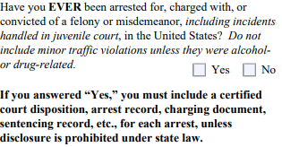
How juvenile arrest history is revealed
Forms
Biometrics
Self Disclosure
Call from Facility

Slide 41
Good Questions to Ask
1. When did you first enter the United States?
2. How did you enter? (i.e. with a visa, without inspection, etc.)
3. What is your current status?
4. Have you ever had contact with anyone from immigration? (i.e. a judge or an ICE or CBP officer)
5. Have you ever been deported before?
6. Have you ever left the United States?
7. Do you have any family members who have green cards or are U.S. citizens?
Notes:
Remember about shame
Talk about violence in Central America and what these kids are fleeing

Slide 42
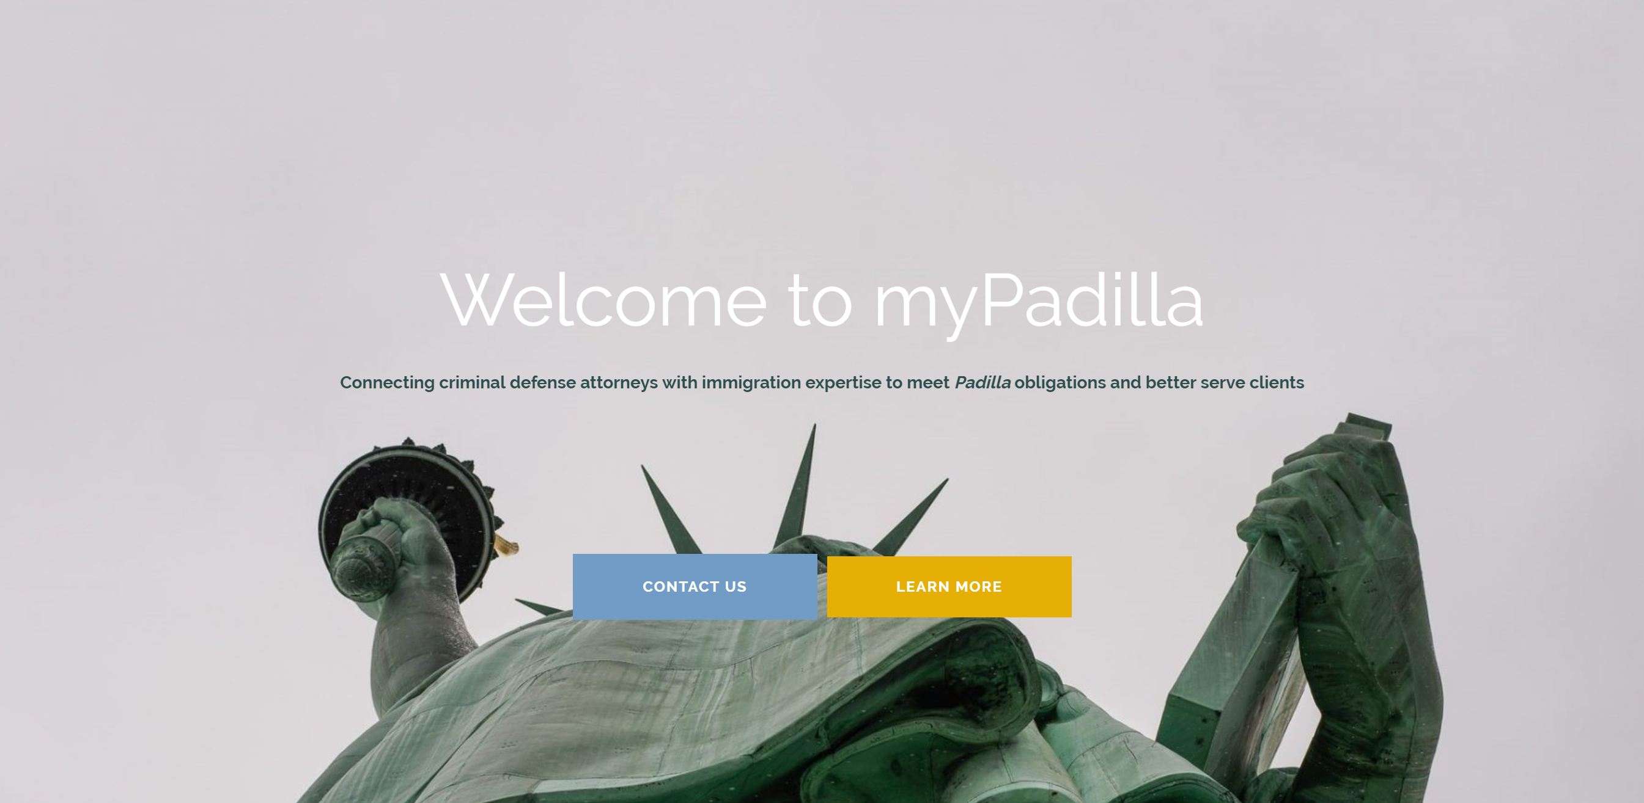

Slide 43
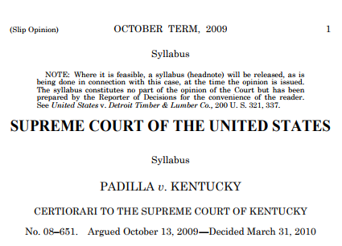
Changes to immigration law have dramatically raised the stakes of a noncitizen’s criminal conviction. While once there was only a narrow class of deportable offenses and judges wielded broad discretionary authority to prevent deportation, immigration reforms have expanded the class of deportable offenses and limited judges’ authority to alleviate deportation’s harsh consequences.

Slide 44
Ex parte Cristian Aguilar (Tx CCA 2017)
“We extend Padilla to the circumstances where a defendant’s guilty plea causes him to automatically lose legal immigration status and become removable. Aguilar’s guilty plea which was based on his counsel’s incorrect advice, will cause him to lose his temporary protected status and render him removable. Because Aguilar has shown he would have not pleaded guilty if he had been correctly advised of the relevant immigration consequences, we hold that ineffective assistance of counsel rendered his plea involuntary and vacate his plea.”
A conviction can make your client
Removable / lose existing status
Ineligible for defensive relief
Ineligible for affirmative status
Ineligible for bond / subject to mandatory detention
Unable to return from abroad
Ineligible to naturalize (become a citizen)
Ineligible to petition for family members
Notes:
Julie case example re LPR inadmissibility

Slide 45
Get immigration advice to satisfy your Padilla obligations in criminal cases
Benefits:
Know what questions to ask your client
Reduce back-and-forth with immigration attorneys
Confidence that you will be connected with an immigration attorney who is willing and available to assist
No more wondering whether your CLE notes from a few years ago are outdated
Know you are giving accurate, tailored advice – not “you’ll probably be deported”
Get better results for your client
Free!
STEPS: 1. Submit intake 2. Receive memo 3. Use memo to rep client

Slide 46
Get in touch!
https://mypadilla.com/contact
Julie Wimmer
jwimmer@gmail.com
mypadillatx@gmail.com
(214) 912-2593
To start using the service
To learn more so that you can be ready when you need it in a case
To schedule a demo, CLE, or training
Tell me more about what you need so we can make something that works for you

Slide 47
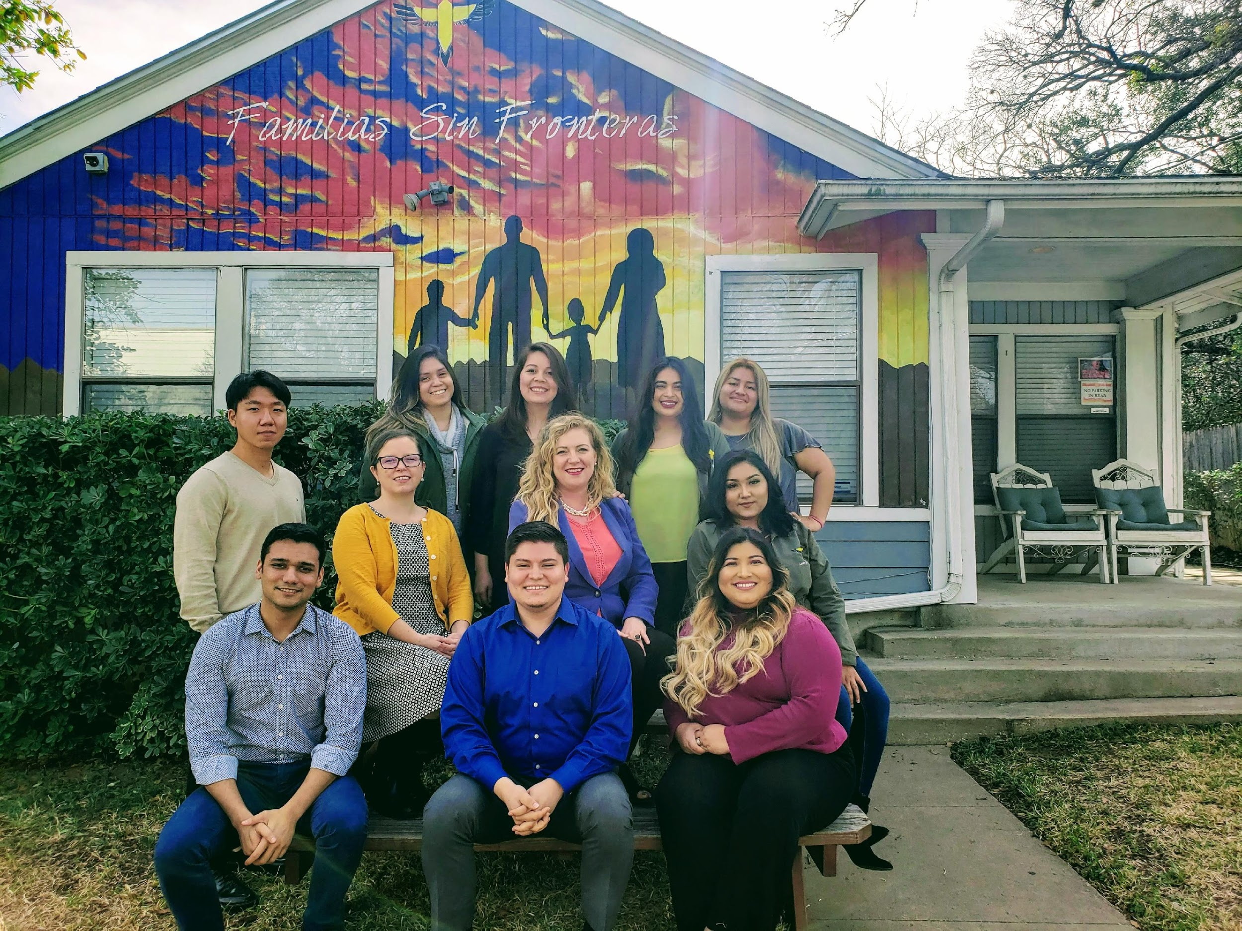
Thank You kate@lincolngoldfinch.com Call or text 512.599.8500
Notes:
What can you do?
GOTV – AG of Texas can settle redistricting lawsuits
Go to Hutto
Go to Karnes
Sign up to take individual cases

